Slide 1
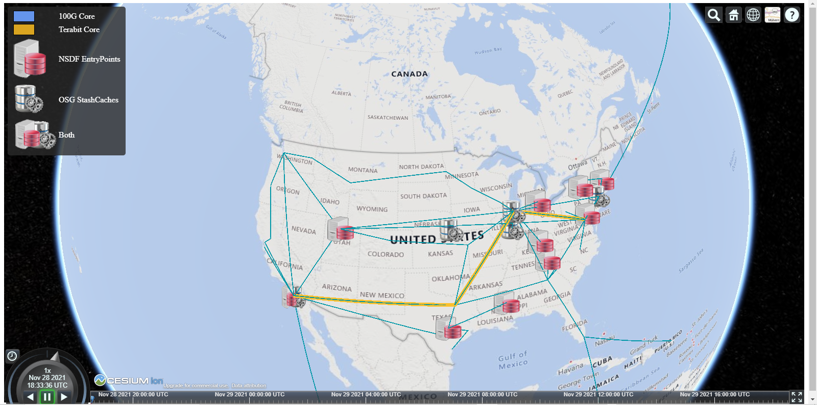
Valerio Pascucci
CENTER FOR EXTREME DATA MANAGEMENT ANALYSIS AND VISUALIZATION (CEDMAV)
SCI Institute, University of Utah

Slide 2
The “Missing Middle”: the Need for a National Data Fabric
Increase in data production
Synchrotron light sources
Telescopes
Lepton and Hadron colliders
X-Ray and Neutron Imaging
Satellite imagery
Neutrino detectors
Light, electron, etc Microscopy
Currently siloed vertical solutions
CI per domain/project
Want shared set of services
Notes:
Need to address the “missing-middle” to develop data-intensive
discovery pathways, as highlighted in NSF presentations

Slide 3
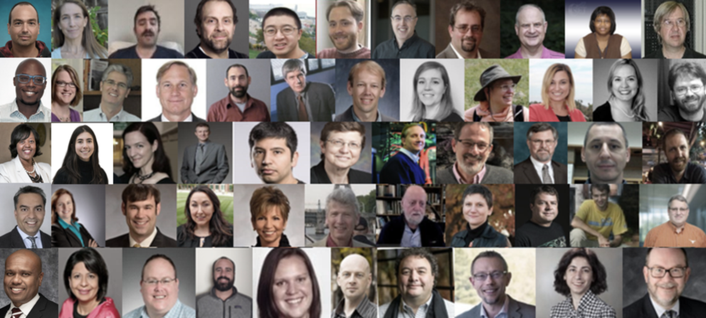
NSDF priorities developed by a community of leaders in CI and application domains
Leverage distributed, heterogeneous hardware resources
Unified software of infrastructure for common services
Workforce development for computer scientists and CI professionals at all levels
Missing millions: lower barrier of entry to science
Scalable services:
Efficient for the largest simulations and experiments
Inclusive for communities with limited resources
Deep integration in application domains
Training and education:
for the applications driven by the applications

Slide 4
The NSDF vision is to make big scientific data easy to use and expand the scientific community working effectively on data-intensive science
Equity of data access opportunities
Interoperability with existing national resources
Intelligent data discovery, delivery, and analytics
Trust, reproducibility, replicability, and transparency
Unification of services with common requirements with specific focus on large scale imaging data
Customization for specific domain science needs

Slide 5
NSDF is designed to integrate and collaborate with many community projects and resources
CHPC
OSG
Fabric
MS-CC
Jetstream 2
SDSC
MGHPCC
CloudBank
TACC
Internet2
Virtual Data Collaboratory
CI Compass
Chameleon
XSEDE
GO FAIR US
Cloud Lab
CyVerse
CHESS
OSN

Slide 6
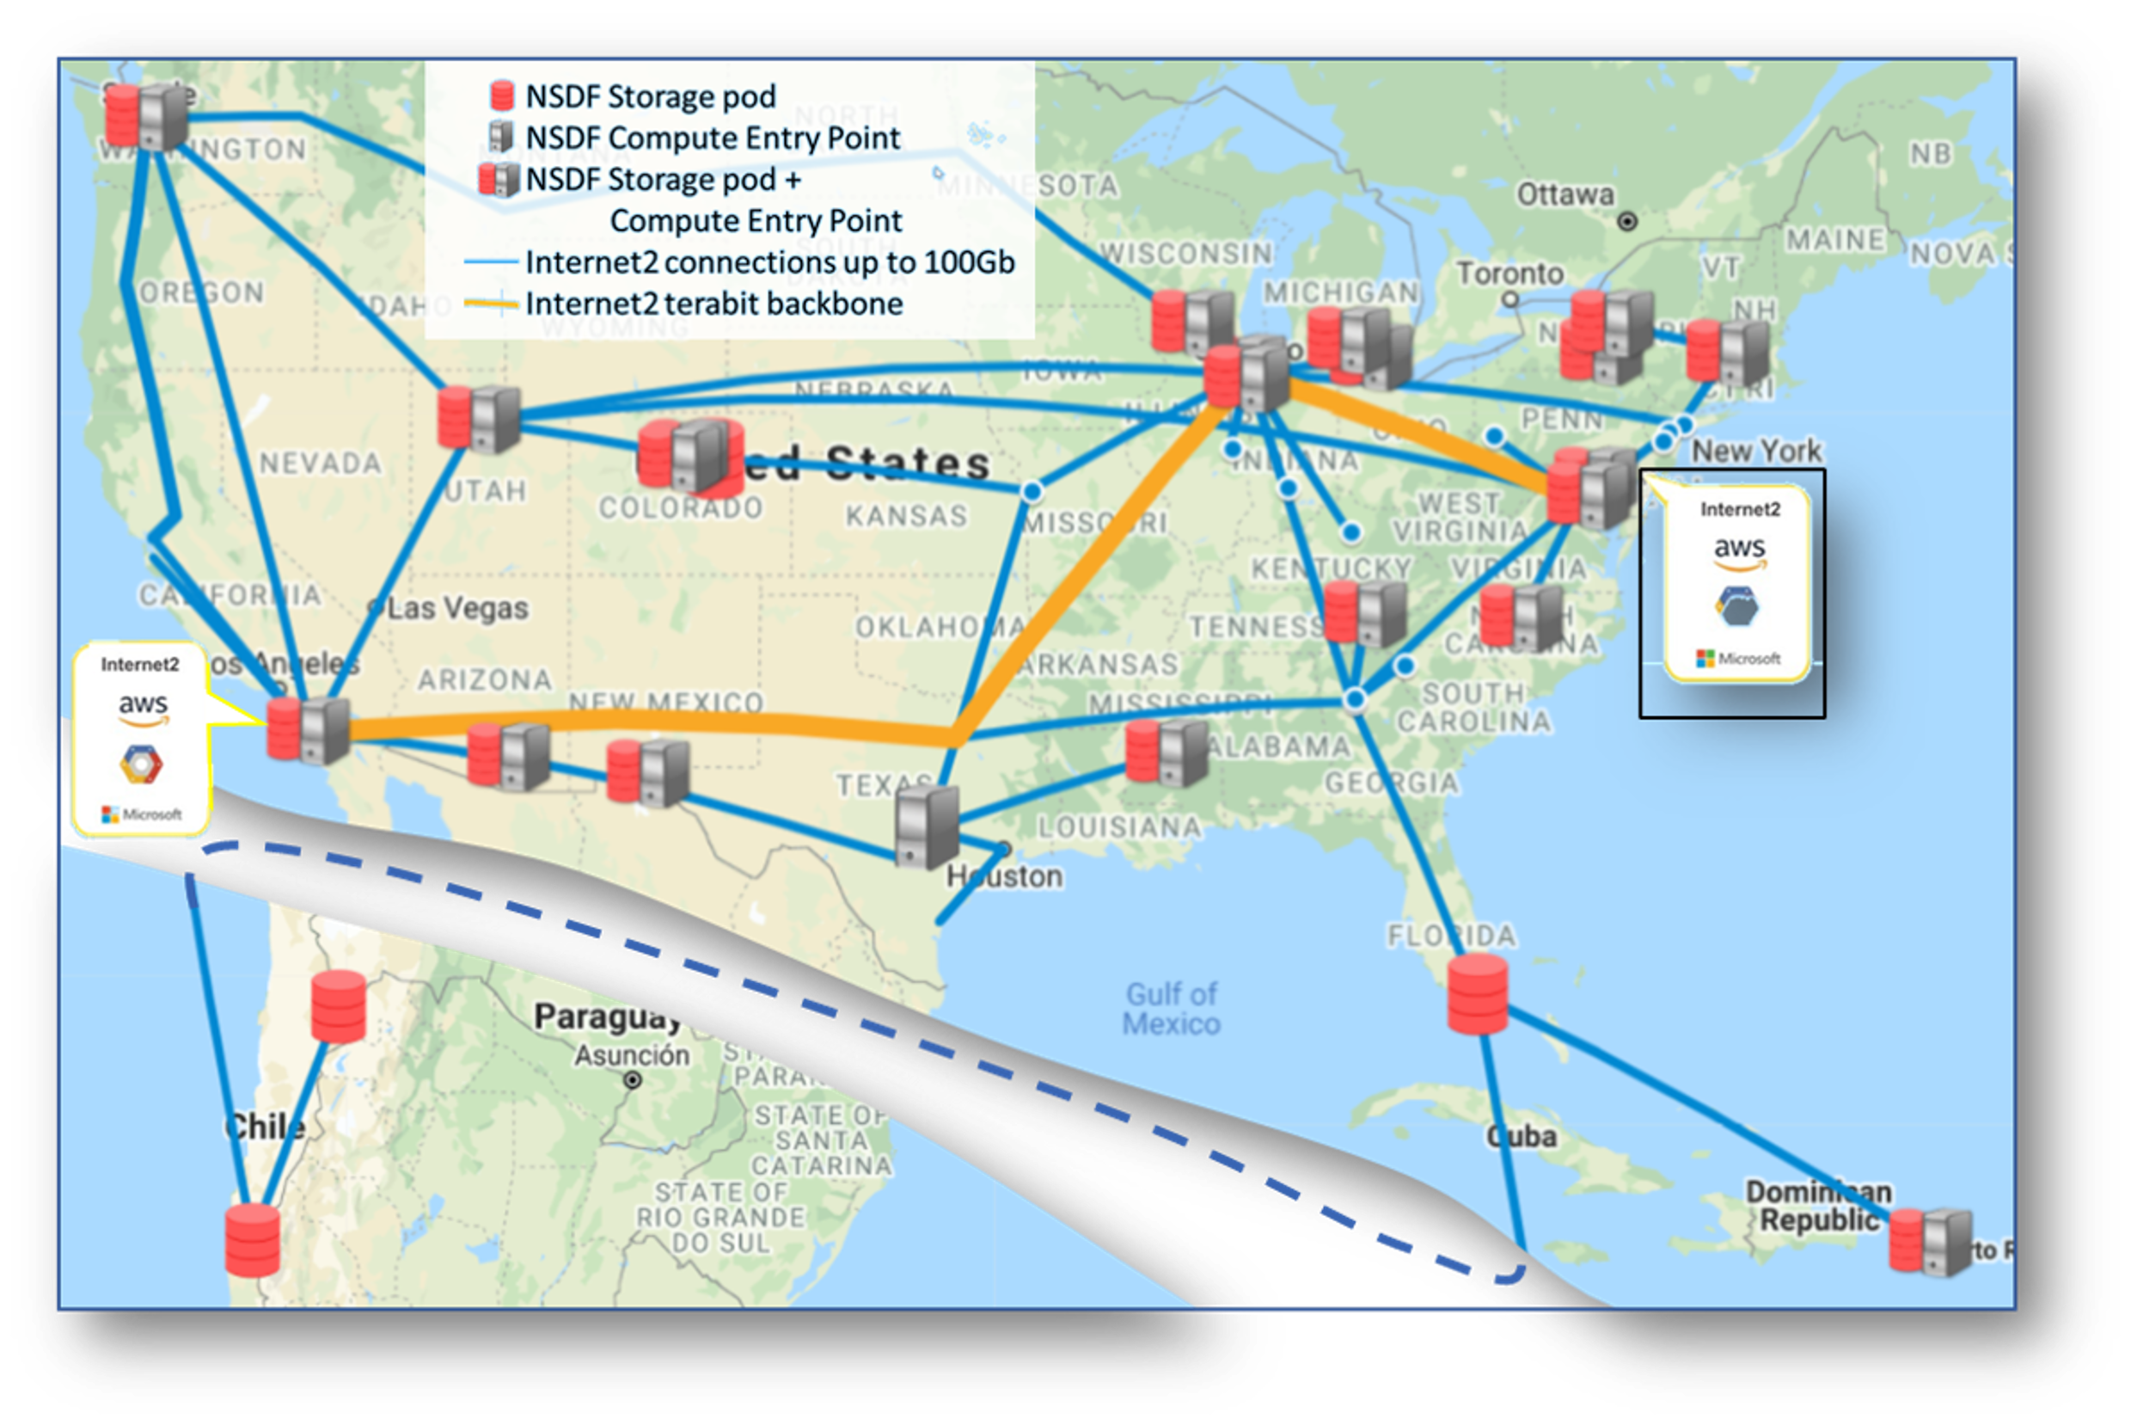
NSDF Overview
Provides integrated access to:
Shared storage
Networking
Computing
Education
Through deployment of:
Hardware components
Software tools
Training activities
Main sites involved in the proposed NSDF construction
connected by the Internet2 backbone

Slide 7
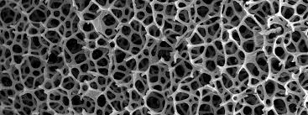
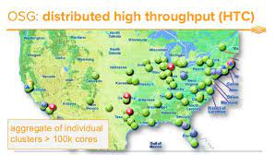
NSDF Application Domains targeted in the initial stage
Materials → Science
Open → Science Grid (OSG)
Comparative → Connectomics
Astronomy→
Earth → Sciences

Slide 8
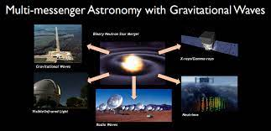
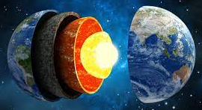
NSDF Application Domains targeted in the initial stage
Materials → Science
Open → Science Grid (OSG)
Comparative → Connectomics
Astronomy→
Earth → Sciences

Slide 9
Motivating Use Cases Materials Science
NSDF will help material scientists:
reduce the timeline for material design, testing, and validation cycle from years to months, with immeasurable benefits to society
enable high throughput, automated design of new materials
Connect the:
Materials Commons data repository, University of Michigan Ann Arbor
Cornell High Energy Synchrotron Source (CHESS),
The University of Texas at El Paso and Individual investigators from minority serving institutions
Digital Rocks Portal

Slide 10
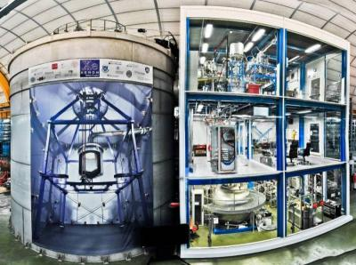
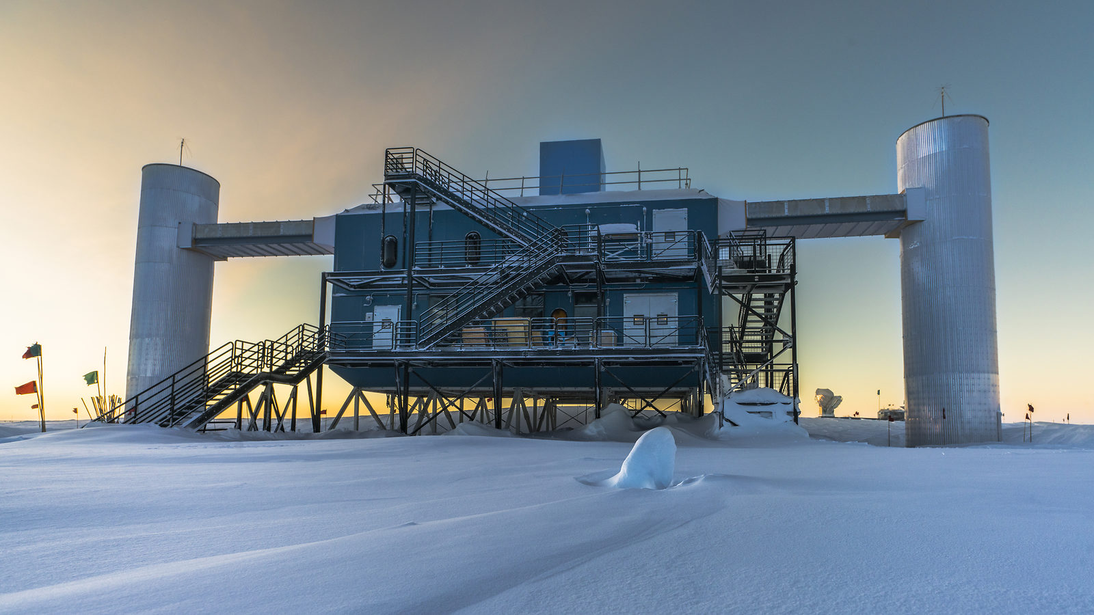
Motivating Use Cases - Open Science Grid
NSDF extend the OSG access to storage and compute resources and provide all scientists with data capabilities that today only a few large projects can afford.
Initial targets:
XENONnT Dark Matter Experiment
IceCube Neutrino Observatory

Slide 11
Motivating Use Cases - Earth Sciences
Bringing together diverse datasets from different providers into a single, accessible NSDF data fabric will give:
researchers access to a distributed computational “earth lab”
develop responses to complex social and environmental challenges
prediction of hurricane patterns,
atmospheric pollution,
sea level rise,
droughts.

Slide 12
Motivating Use Cases - Comparative Connectomics
NSDF will SUPPORT Neuroscientists to engage in comparative connectomics:
across different areas of the brain in an individual,
across individuals at different developmental or disease states, and
across different species.
It will SUPPORT Neuroscientists to shed new light on how natural neural systems process information and possibly inspire architectures for artificial ones.

Slide 13
Motivating Use Cases - Astronomy
NSDF will create an ecosystem that:
Allow many astronomy projects to operate with data sets whose size was previously unthinkable
Move multi-messenger astrophysics (one of the 10 NSF’s Big Ideas) from the bleeding edge of technology into routine operations
allow the study of the most extreme and mysterious objects in the universe

Slide 14
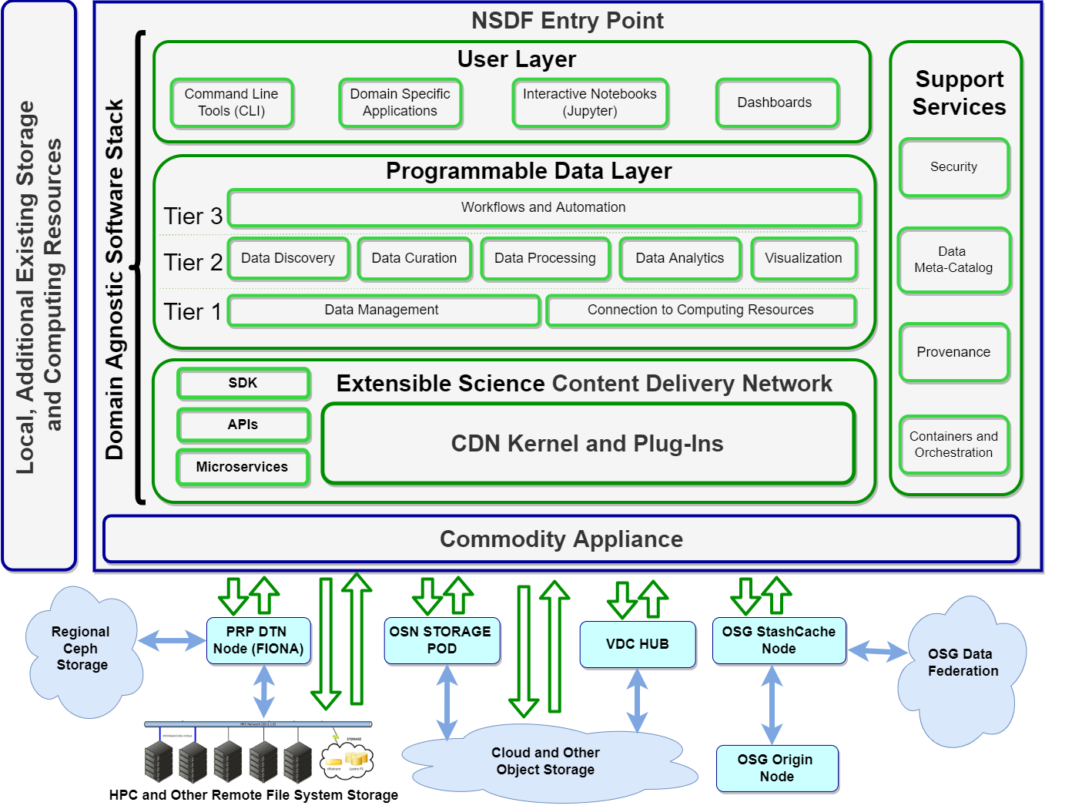
NSDF software stack builds on an Extensible Science Content Delivery Network

Slide 16
CDN for Science
Special adaptation to the patterns of science use cases involving few massive files (images from experiments, simulations, ..), and many small ones (metadata, derived quantities,…)
Horizontal scaling: data access that does not require user sessions (stateless).
Overcome object storage limitations
High latency
Operation granularity that may not match well requirements of network optimization
Add extra security layer: avoid direct and dangerous access to origins/producers
100%
90%
80%
70%
60%
50%
40%
30%
20%
10%
0%

Slide 17
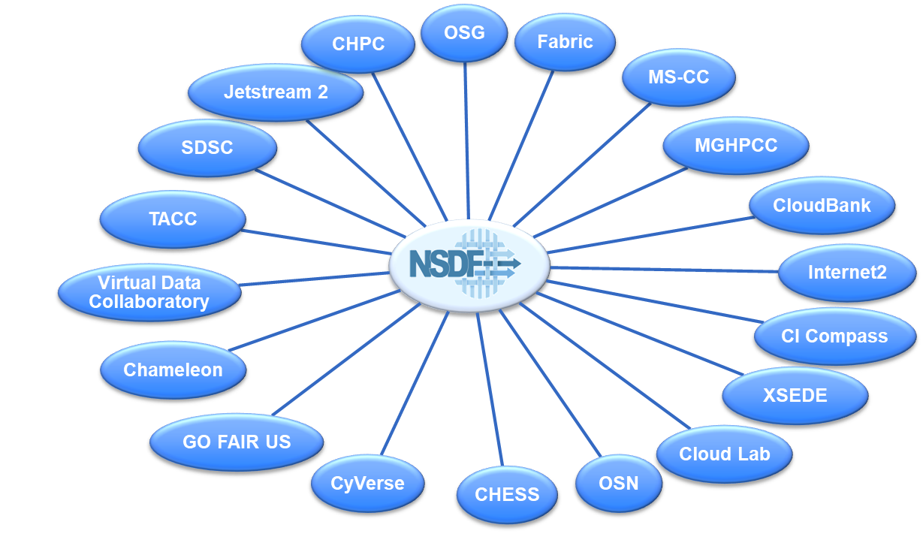
Federation of Federations
lightweight deployment: near real-time dynamic creation of clusters
distributed repository of coherent namespaces with uniquely identified objects
separate namespace can merge or split without any timelapse / integration

Slide 18
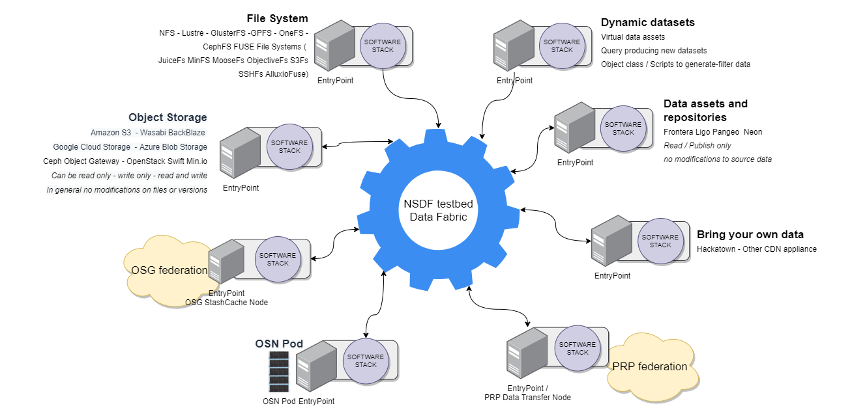
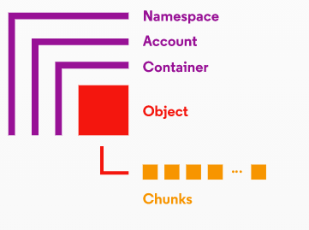
Federation of Federations
Global namespace simplifies file access:
files can be moved between file systems and storage devices with no impact to users and applications
Each actor has a pre-assigned unique prefix (e.g., UCSD, UMich, etc.) and each object is globally uniquely identified.

Slide 19
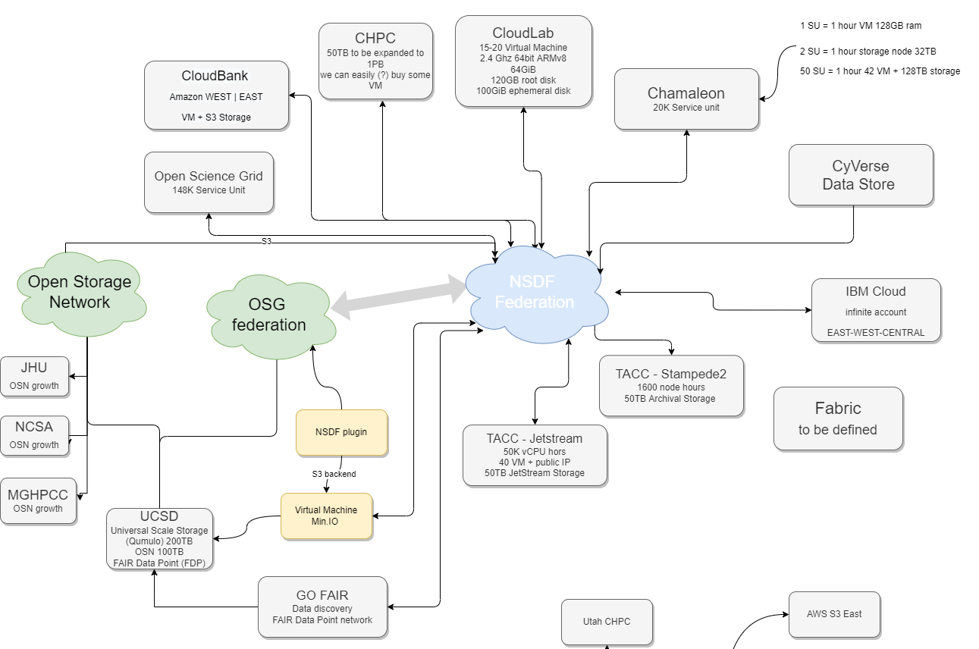
Federation of Federations
Global namespace simplifies file access:
files can be moved between file systems and storage devices with no impact to users and applications
Each actor has a pre-assigned unique prefix (e.g., UCSD, UMich, etc.) and each object is globally uniquely identified.
Current NSDF testbed

Slide 20
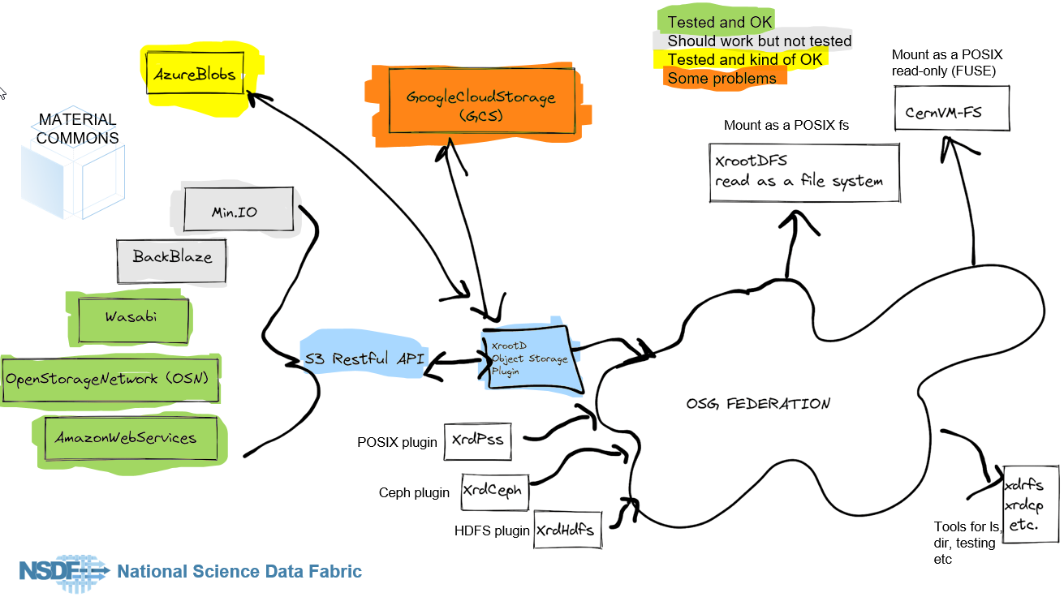
Prototype and Preliminary Tests NSDF Plugin merges OSN/OSG Federations

Slide 21
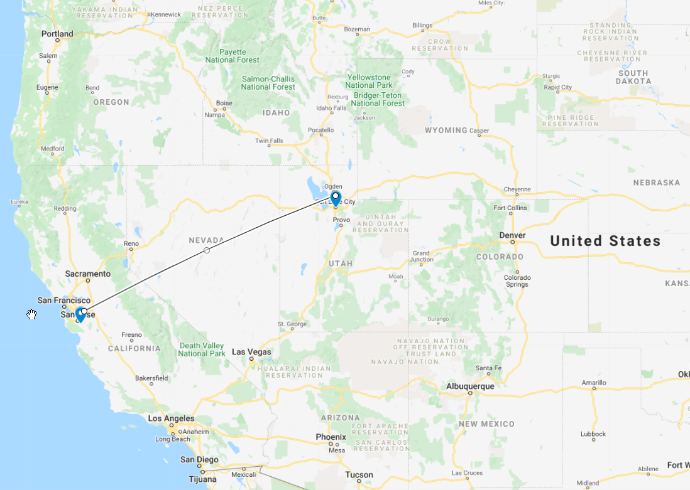
XROOTD-SERVER-WEST-1
xrootd -c /mnt/d/GoogleDrive/.config/xrootd/aws.config
xrootd running @SCI
Amazon S3 (us-west-1)

Slide 22
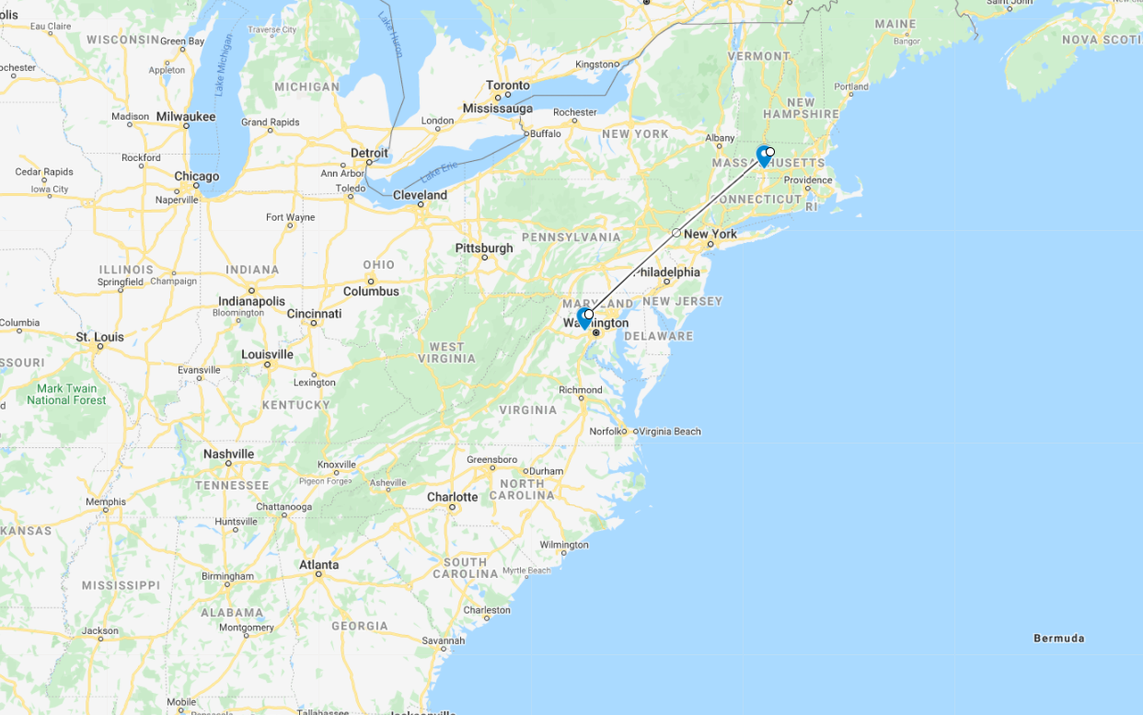
XROOTD-SERVER-EAST-1
xrootd -c /mnt/d/GoogleDrive/.config/xrootd/osn.config
OSN
(Massachusetts Green High Performance Computing Center)
OVH cloud VM
(east)

Slide 23
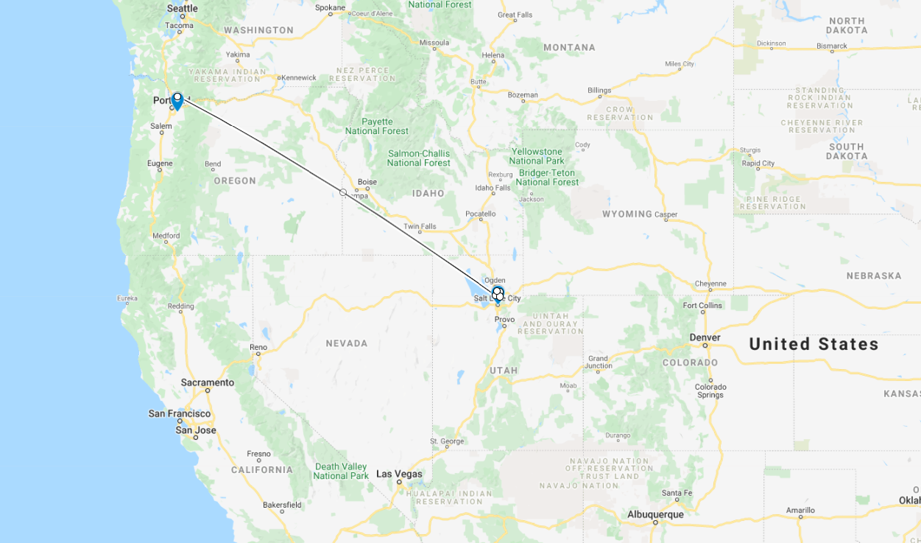
XROOTD-SERVER-WEST-2
xrootd -c /mnt/d/GoogleDrive/.config/xrootd/wasabi.config
Wasabi S3 Oregon
xrootd running @SCI

Slide 24
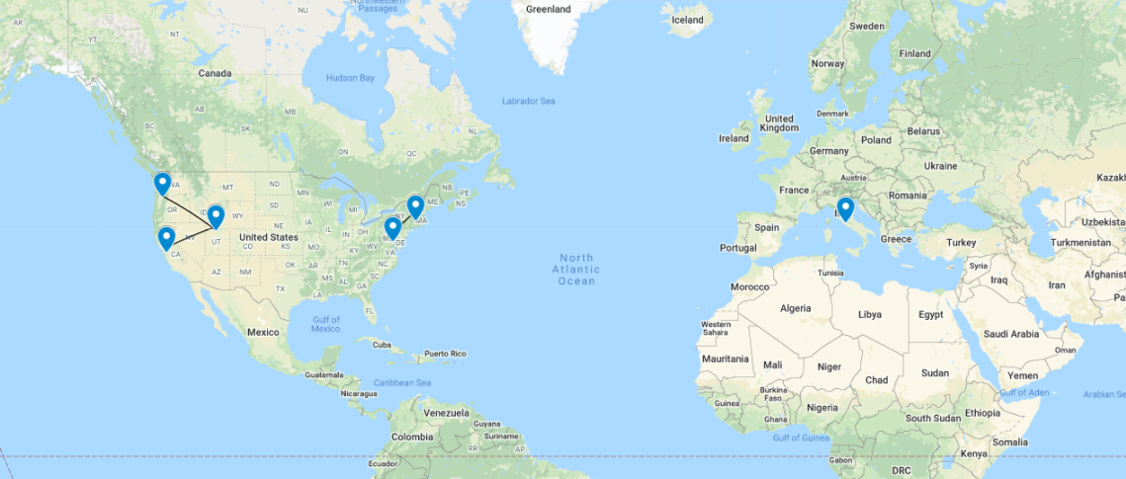
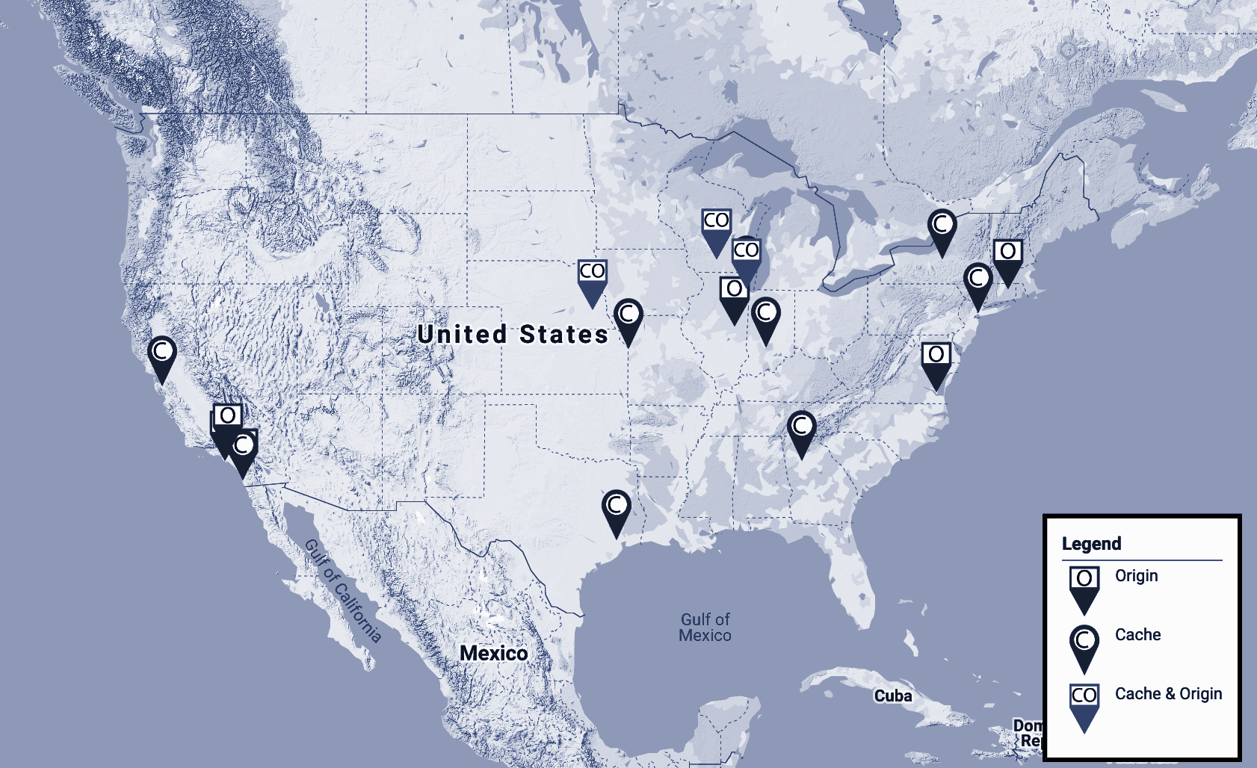
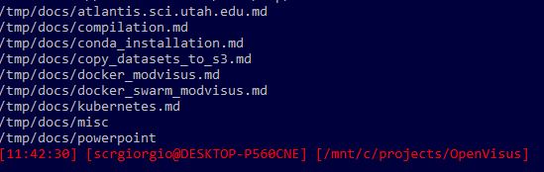
XROOTD client tools and XrootDFS
OSG federation +
XROOTD-SERVER-WEST-1+
XROOTD-SERVER-WEST-2+
XROOTD-SERVER-EAST-1
XrootD client
EUROPE

Slide 25
Benchmarks of raw data transfers
8 Workers
16 Workers
24 Workers
Transfer Speed in MB/S
Block Size in Bytes
Block Size in Bytes
Block Size in Bytes

Slide 26
Benchmarks of raw data transfers
Block size 4MB
Block size 2MB
Block size 1MB
Transfer Speed in MB/S
Number of Workers
Number of Workers
Number of Workers

Slide 27
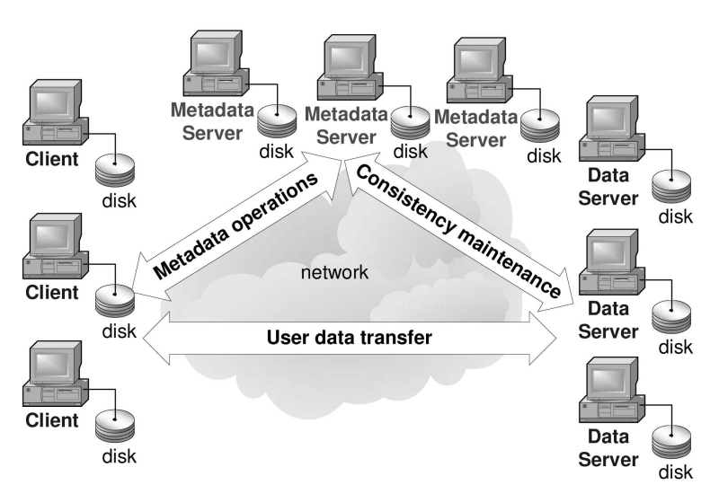
Develop Special Support for Distributed Metadata for Science
Metadata for science: distributed NoSQL key-value database that is consistent across all federations with access in the order of milliseconds.
Read-write eventual consistency.
NSDF CDN creates a Meta Catalog with:
metadata transformation services to inject seamlessly domain-specific metadata
mechanisms for allowing users to query data based on desired attributes.
common metadata for cross-domain discovery
a global namespace to resolve name conflicts

Slide 28
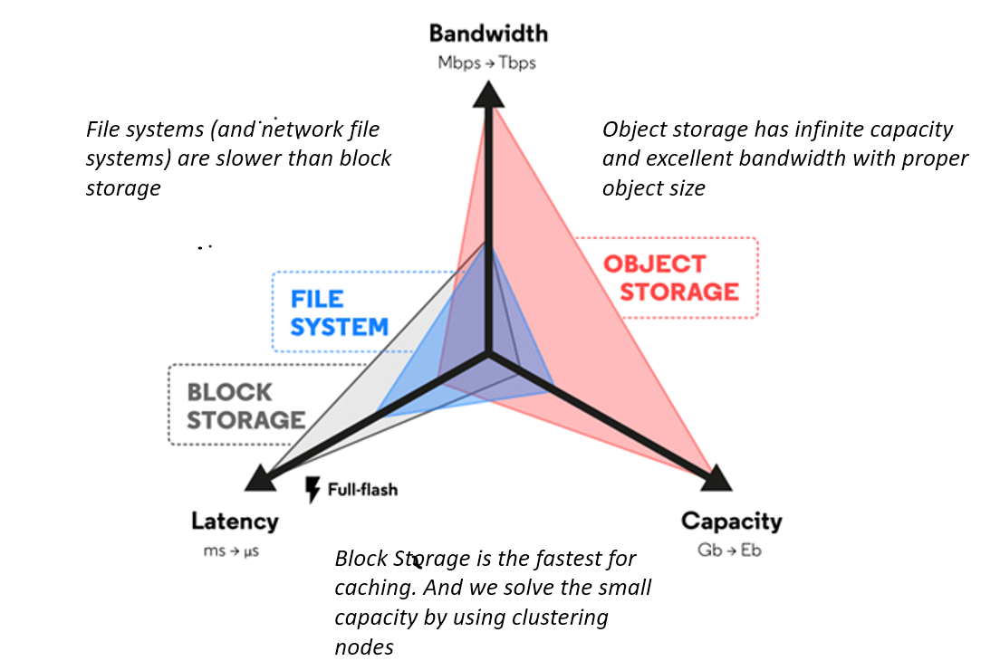
NSDF Supports the Business Case of Data Intensive Science
Minimize cost by:
limiting EGRESS
prioritizing resource access at runtime (traffic monitoring)
downgrade storage category for stale data (move to archive)
self-adapting cache allocation (push, pull, full copy, move) with custom cache eviction
Leverage distributed resources: multi cloud (Amazon, Wasabi, …) and hybrid strategy (Min.IO, OSN, SDSC) …
Fingerprints of Data Access Patterns: Fine-grained tracking of data movements for real use cases, including data layouts and formats
Leverage local hardware for fast block storage caching; consistent hashing permits distributed local storage

Slide 29
Science, Training, Education and Outreach Activities
Curriculum Development/ Training Sets
Workforce Training
Inclusion & Diversity Main Drivers:
Minority Serving Cyberinfrastructure Consortium (MS-CC)
Computing Alliance of Hispanic-Serving Institutions (CAHSI)
HBCUs, TCUs, HSIs, and other MSIs
Annual Symposium
Student Internships
Training Materials Science
Training Earth Sciences
Training Comparative Connectomics
Training Astronomy
Training OSG

Slide 30
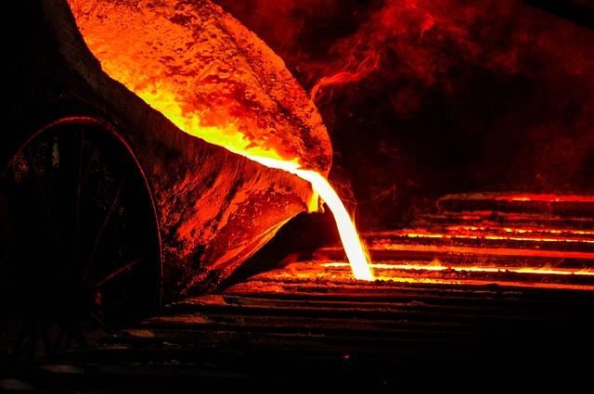
Science, Training, Education and Outreach Activities
Curriculum Development/ Training Sets
Workforce Training
Inclusion & Diversity Main Drivers:
Minority Serving Cyberinfrastructure Consortium (MS-CC)
Computing Alliance of Hispanic-Serving Institutions (CAHSI)
HBCUs, TCUs, HSIs, and other MSIs
Annual Symposium
Student Internships
Training Materials Science
Training Earth Sciences
Training Comparative Connectomics
Training Astronomy
Training OSG

Slide 31
NSDF VISION of Data Democratization
The NSDF vision is to establish a globally connected infrastructure in which scientific investigation is unhindered by the limitations of extreme data. With a democratized data access framework, even scientists using massive experimental and simulation data will not be distracted from scientific discovery, training activities, or dissemination of scientific findings in society.

Slide 32
NSDF MISSION of Data Democratization
The NSDF mission is to democratize access to large-scale scientific data by developing production-grade scalable solutions to data storage, movement, and processing that can be deployed on commodity hardware, cloud computing, and HPC resources. NSDF will make software tools easy to use for scientists and easy to customize for the need of specific application domains. NSDF will facilitate training opportunities for current and future generations of scientists, including those having only access to resource constrained environments.

Slide 33
The end

