Slide 1
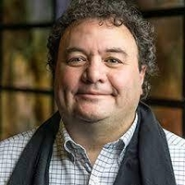
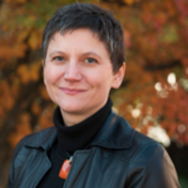
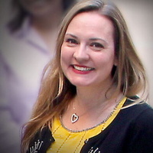
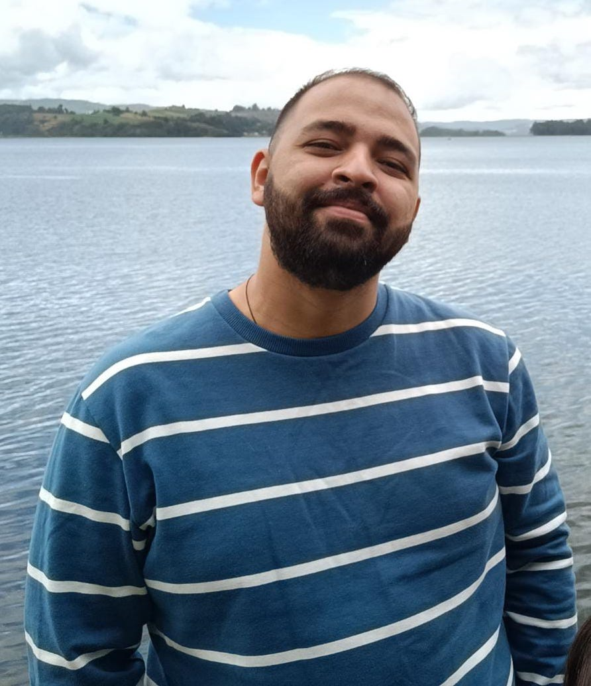
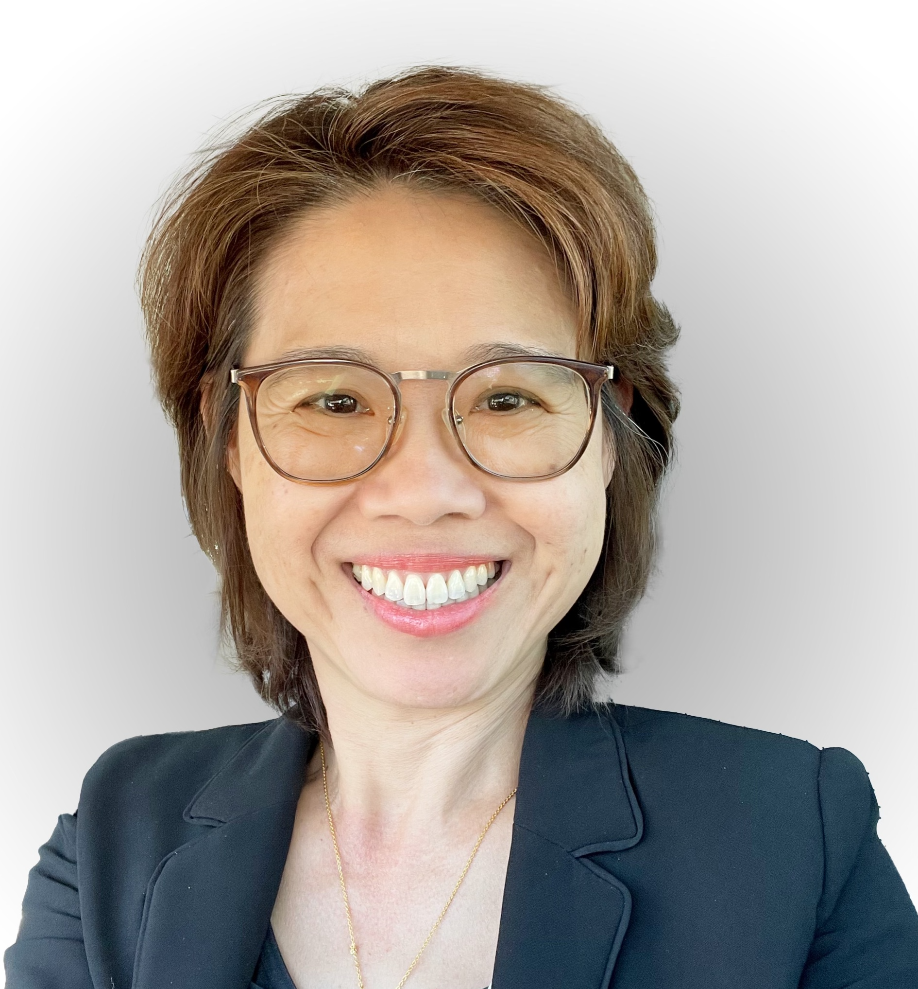
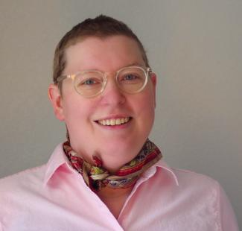
A National Science Data Fabric to Democratize Data Access and Reusability
Moderators: Valerio Pascucci (University of Utah), Michela Taufer (University of Tennessee Knoxville,
Christine Kirkpatrick (San Diego Supercomputer Center)
Participants: Heberth Martinez (University of Tennessee Knoxville), Keara Soloway (CHESS),
Chuntida Harinnitisuk (University of Texas Health San Antonio), Amy Roberts (University of Colorado Denver)
Notes:
INSERT NSF GRANT NUMBER

Slide 4
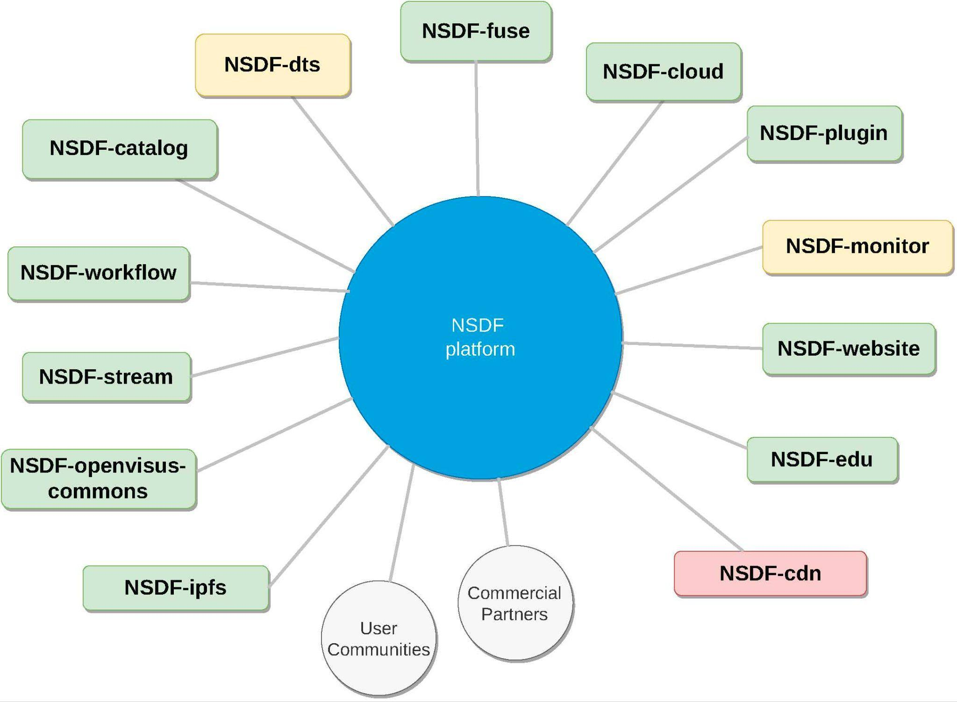
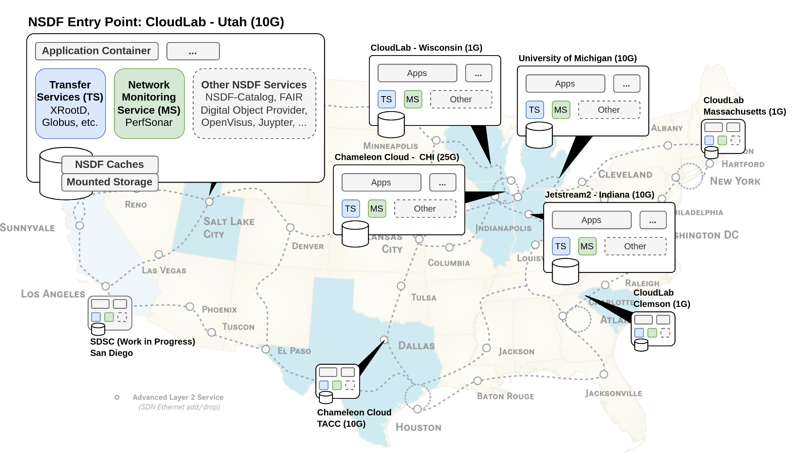
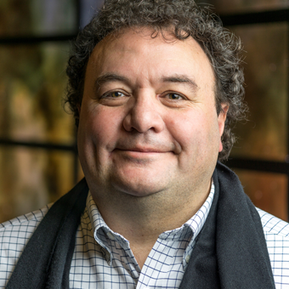
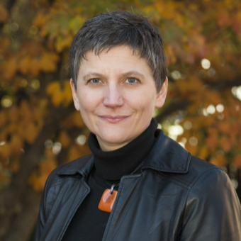
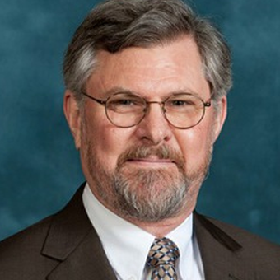
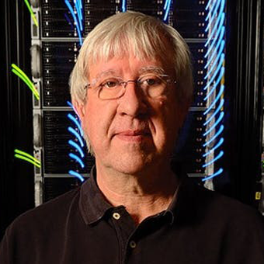
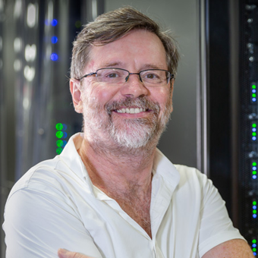
National Science Data Fabric
Integrate existing infrastructure (e.g., Fabric) seamlessly for users
Link Cloud providers, Internet services, and user interfaces
Implement comprehensive software stack and interfaces
Tighty couple facilities, services, and AI through AI-assisted software tools and data repositories

Slide 5
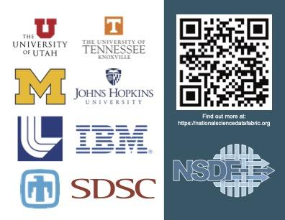
Get our card and stickers!

Slide 6
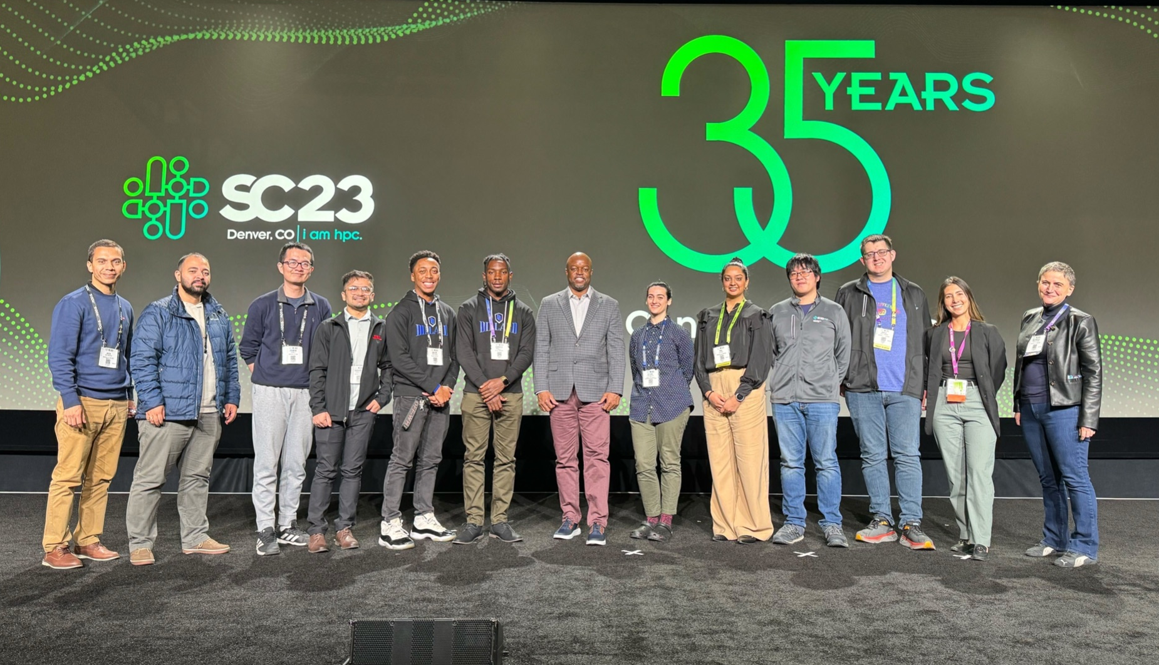
How to get involved
Attend our All Hands Meeting (February 28-March 1, La Jolla, CA)
Stay tuned for more information about travel support for early career researchers!
Attend our Distinguished Speaker Webinar: “Big Data at Synchrotron X-ray User Facilities: Challenges and Opportunities” with Dr. Joel Brock, Director, Cornell High Energy Synchrotron Source (CHESS) on December 12, 2pm ET
Participate in a User Community Interview
Follow NSDF on X and LinkedIn

Slide 7
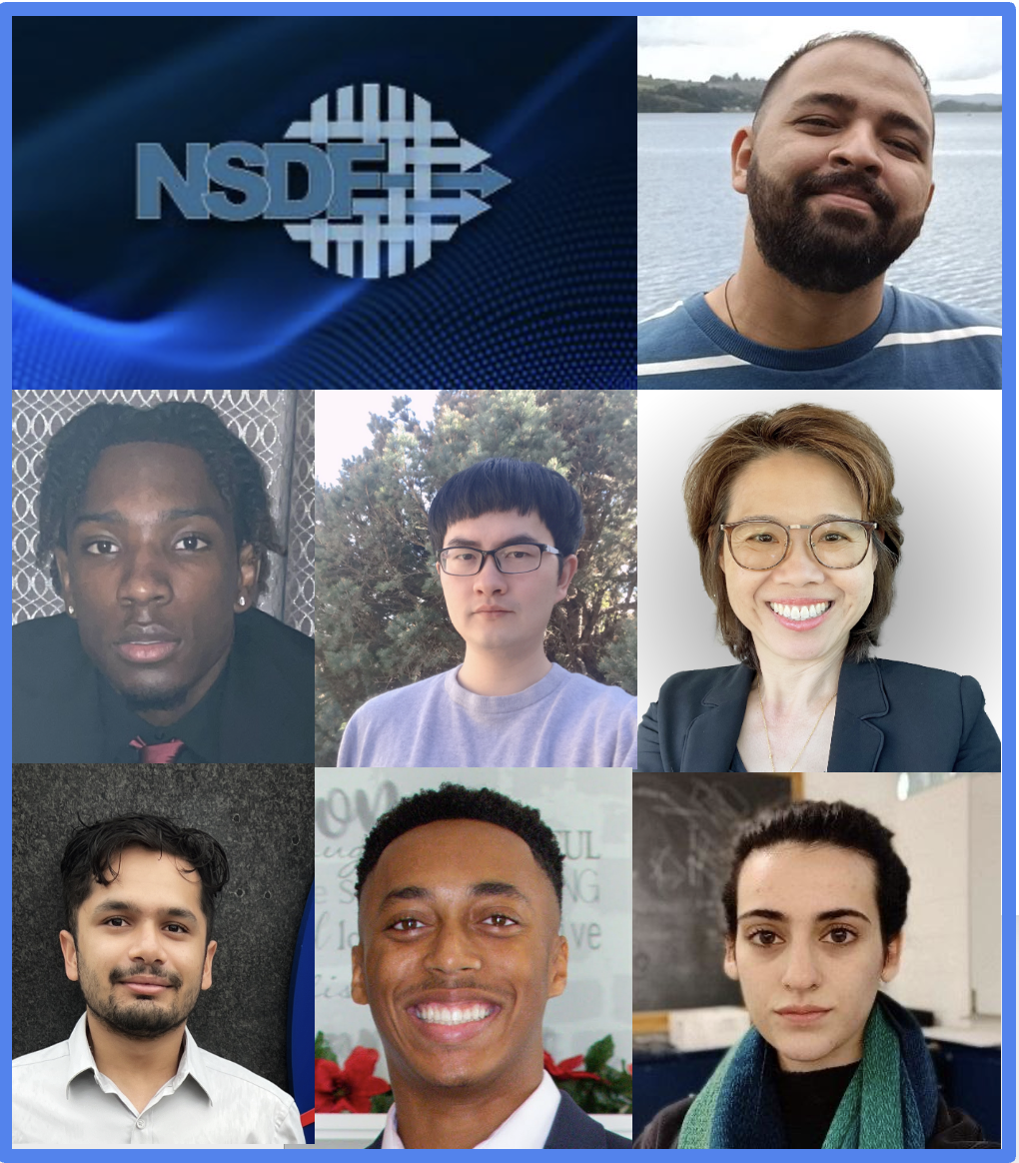
Travel Award to SC23 for Early Career Scholars

Slide 8
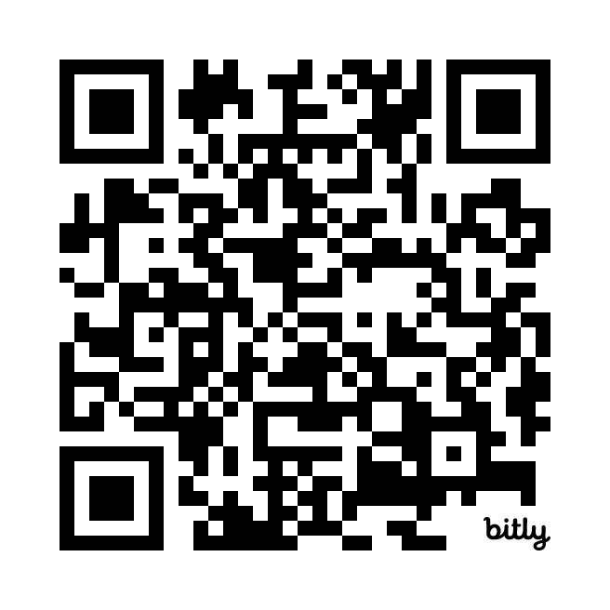
Help us learn more about you!
Take our survey (2 mins)

Slide 9
Testimonials: Challenges and Solutions in
Data Democratization
Heberth Martinez: The NSDF Catalog: A Lightweight Indexing Service for Democratizing Data Delivery
Keara Soloway: NSDF at Cornell High Energy Synchrotron Source (CHESS)
Chuntida Harinnitisuk: Navigating Data Expansion: Coping with Storage Islands and Data Analysis Complexity
Amy Roberts: What’s Possible in Dark Matter Science?

Slide 10
A National Science Data Fabric to Democratize Data Access and Reusability
Moderators: Valerio Pascucci (University of Utah), Michela Taufer (University of Tennessee Knoxville,
Christine Kirkpatrick (San Diego Supercomputer Center)
Participants: Heberth Martinez (University of Tennessee Knoxville), Keara Soloway (CHESS),
Chuntida Harinnitisuk (University of Texas Health San Antonio), Amy Roberts (University of Colorado Denver)
Notes:
INSERT NSF GRANT NUMBER

Slide 11
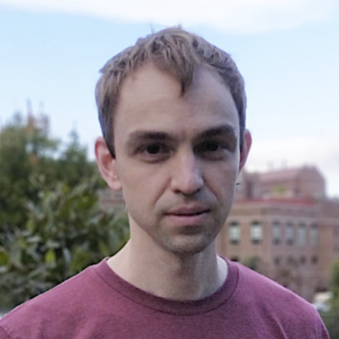
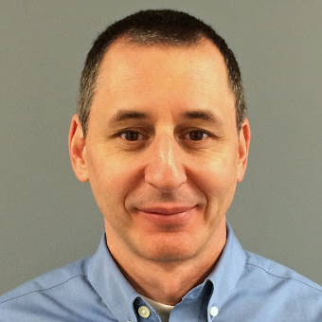
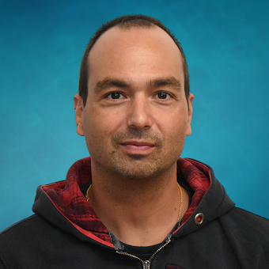
NSDF-Catalog: Indexing Service for Democratizing Data Delivery
NSF: 2138811 (NSDF) and 2028923 (SOMOSPIE); IBM; ACCESS-CI/XSEDE: TG-CIS210128; Chameleon: CHI-210923

Slide 12
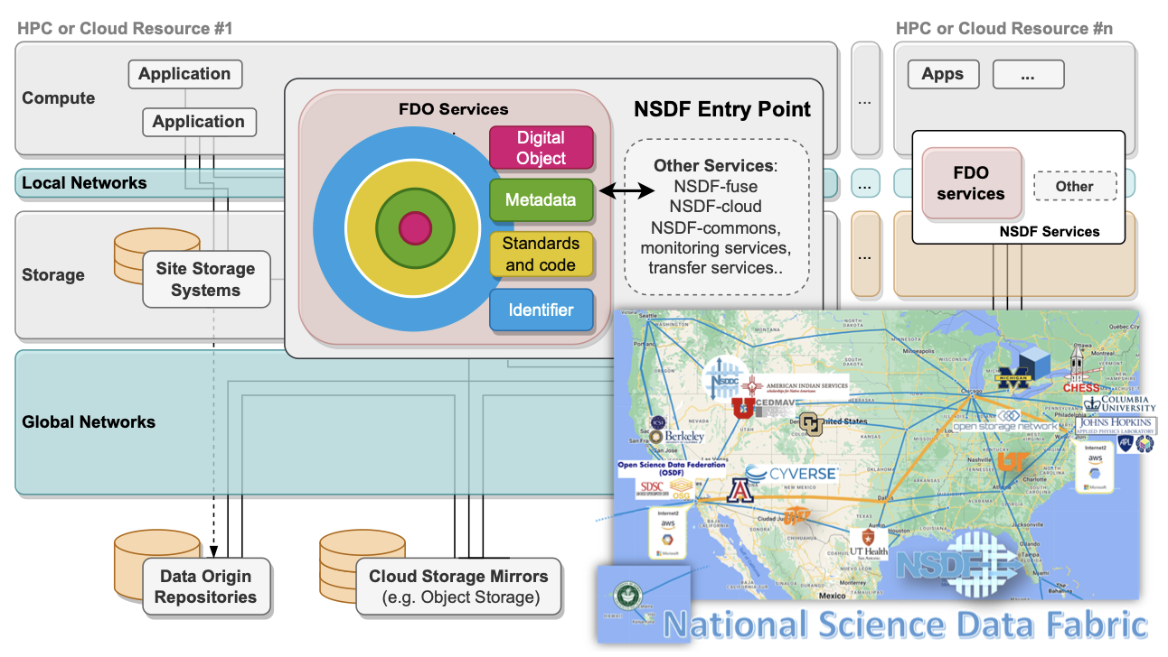
The IDEA of NSDF:
Provide an easy to deploy software stack as an Entry Point to allow connecting and interacting with a wide range of research infrastructure.
A Platform Agnostic Testbed for Democratizing Data Delivery

Slide 13
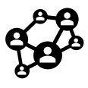
Services &
Building Blocks
Communities
Data
NSDF PLATFORM
Networking
Monitoring
Communities
Service monitoring
Users and commercial partners
Monitoring
Data
Networking
Data inventory and discovery
Network characterization

Slide 14
Services &
Building Blocks
Communities
Data
Education material, commercial clouds
NSDF PLATFORM
Networking
IBM
AWS
Cameleon
Jetstream
NSDF-Edu
Monitoring
Communities
Service monitoring
Users and commercial partners
Monitoring
Data
Networking
Data inventory and discovery
Network characterization

Slide 15
Services &
Building Blocks
Monitoring
Tracking data movements
Data
NSDF PLATFORM
Networking
NSDF-Monitoring
Monitoring
Communities
Service monitoring
Users and commercial partners
Data
Networking
Data inventory and discovery
Network characterization

Slide 16
Services &
Building Blocks
Data
NSDF PLATFORM
Networking
Network optimization
Monitoring
Communities
NSDF-Plugin
NSDF-cdn
Service monitoring
Users and commercial partners
Data
Networking
Data inventory and discovery
Network characterization

Slide 17
Services &
Building Blocks
Data
Storage, transfer,
visualization NSDF-Catalog
NSDF PLATFORM
NSDF-Catalog
NSDF-Fuse
NSDF-Stream
NSDF-Openvisus
Monitoring
Communities
Service monitoring
Users and commercial partners
Data
Networking
Data inventory and discovery
Network characterization

Slide 18
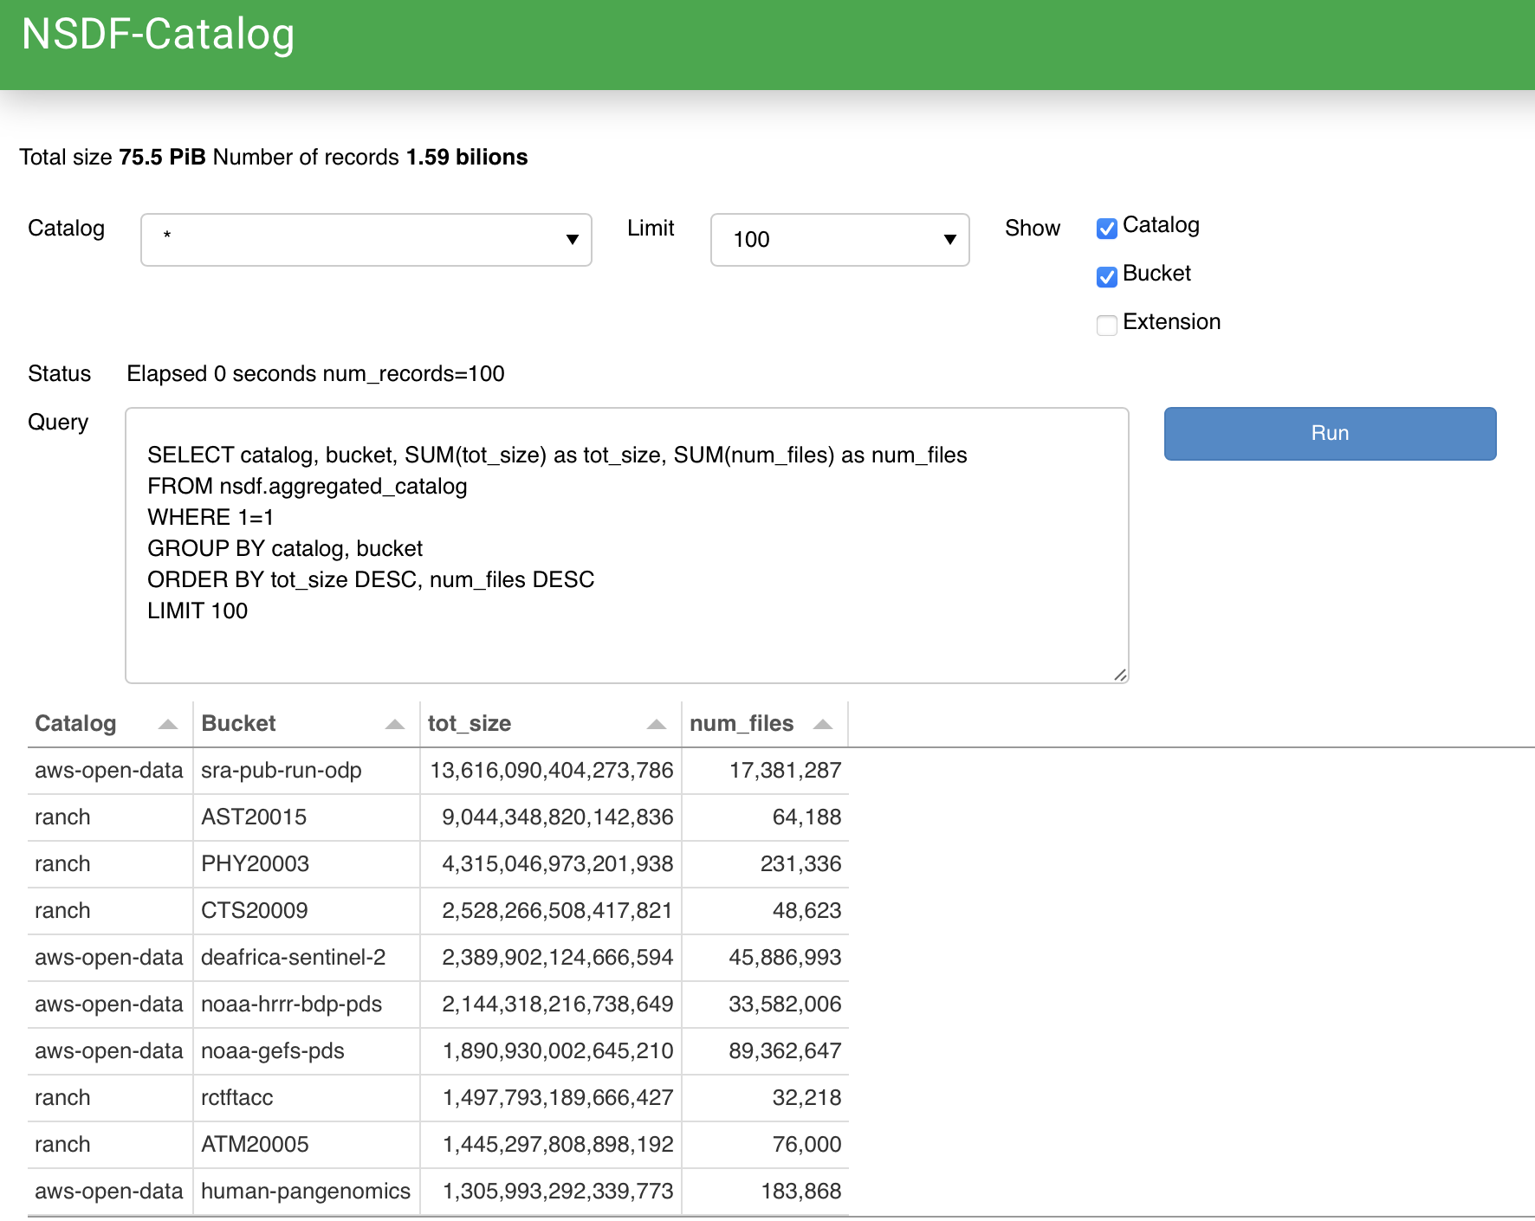
NSDF-Catalog
Lightweight indexing service for democratizing data delivery:
Support different repositories’ providers
Potentially trillions of datasets
Solutions containerized
Efficient indexing
Easy to use

Slide 19
NSDF-Catalog: Challenges
The necessity of multiple harvesting strategies:
Inputs obtained from different repository providers vary a lot
Different protocols to collect the data
The ingest performance change with the hardware
The correct order to improve the query performance
The fragmentation strategies for the different repositories

Slide 20
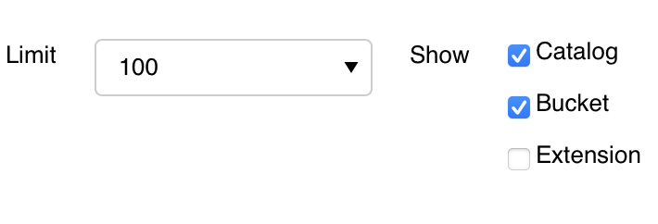
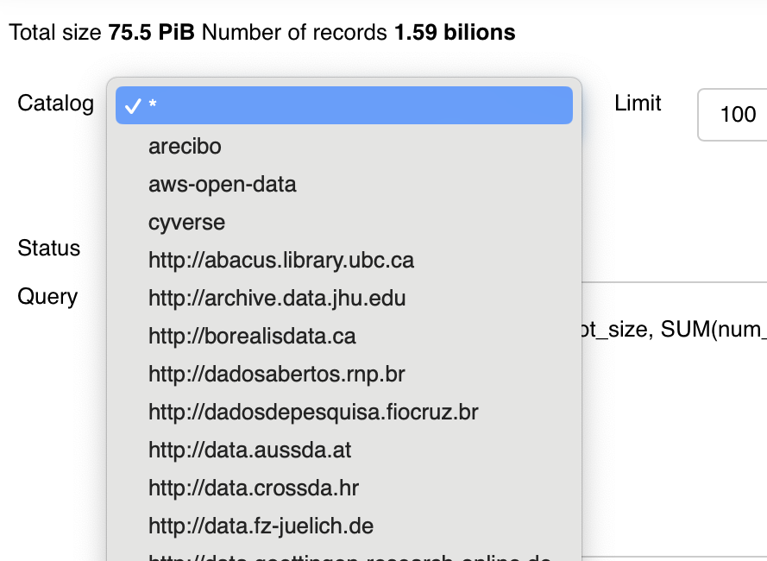
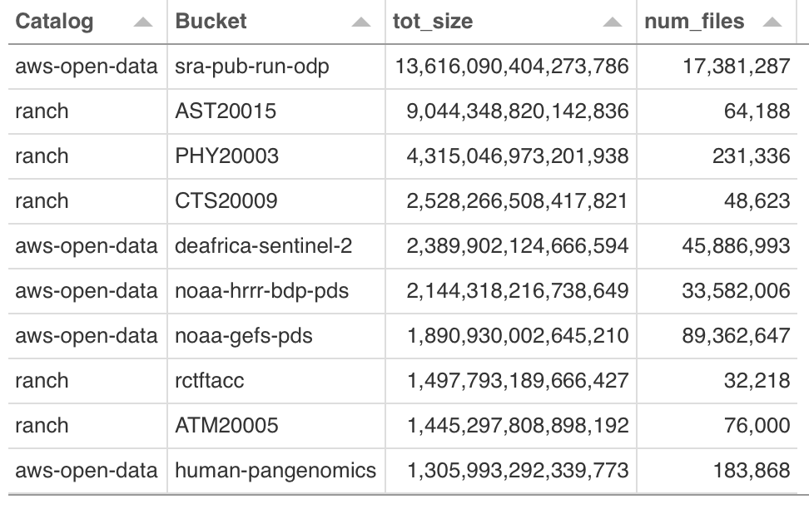
NSDF-Catalog: How to use it?
Select Catalog > Apply Filters > Visualize

Slide 21
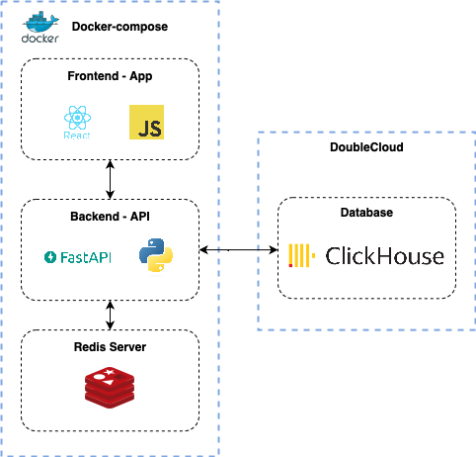
WIP: Catalog Comparison Tool
The NSDF Catalog Comparison Tool compares multiple catalogs presenting in a simple way the proxy fragmentation, the number of available buckets, and the total data stored in TeraBytes.

Slide 22
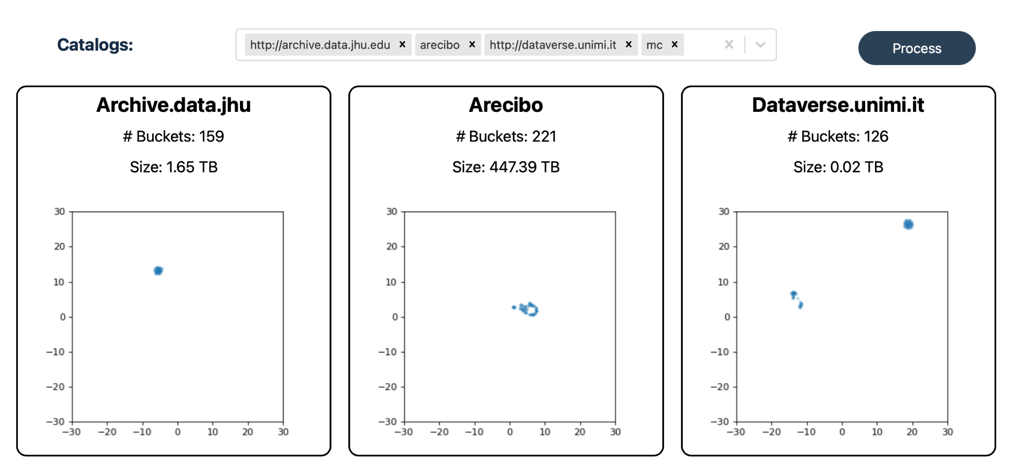
Catalog Comparison Tool: How to use it?
Select the datasets
Visualize the information

Slide 23
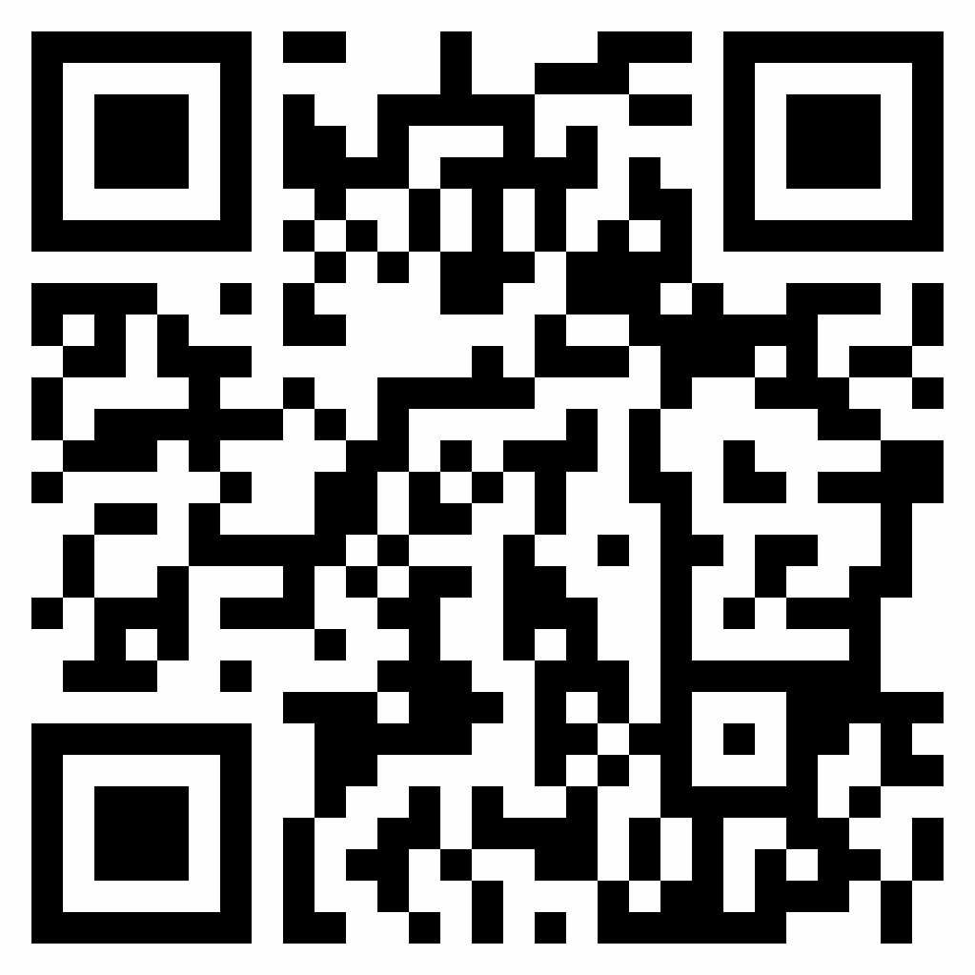
Find out more . . .
Dr. Michela Taufer Global Computing Lab University of Tennessee
Find out more about NSDF-Catalog:
http://nationalsciencedatafabric.org/
http://github.org/nsdf-fabric
Dr. Valerio Pascucci
University of Utah

Slide 24
A National Science Data Fabric to Democratize Data Access and Reusability
Moderators: Valerio Pascucci (University of Utah), Michela Taufer (University of Tennessee Knoxville,
Christine Kirkpatrick (San Diego Supercomputer Center)
Participants: Heberth Martinez (University of Tennessee Knoxville), Keara Soloway (CHESS),
Chuntida Harinnitisuk (University of Texas Health San Antonio), Amy Roberts (University of Colorado Denver)
Notes:
INSERT NSF GRANT NUMBER

Slide 25
NSDF @ Cornell High Energy Synchrotron Source
Keara Soloway she/they (Cornell University)

Slide 26
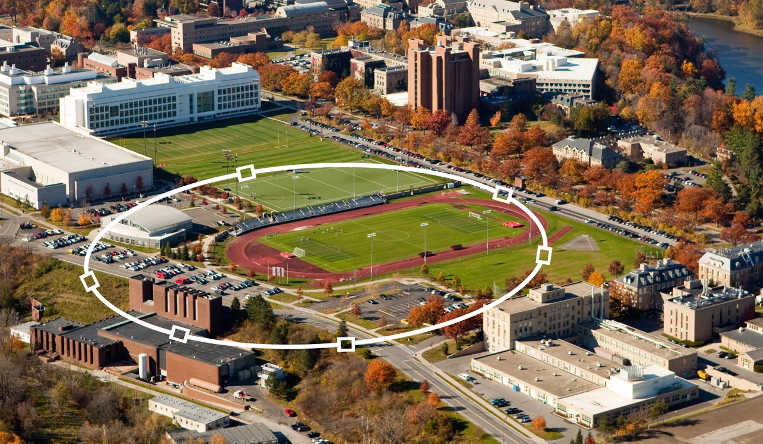
What is CHESS?
A high energy synchrotron source provides X-rays to researchers across many different domain sciences
CHESS is a national user facility funded by NSF, AFRL, and NIH
CHESS has seven X-ray beamlines specializing in macromolecular crystallography, structural biology, quantum materials, and materials sciences
CHESS beamline scientists provide support to users to setup experiments and collect / analyze data
Began NSDF collaboration in March 2022
https://www.chess.cornell.edu
Notes:
Some words used to describe CHESS: "boutique", "educational"
Specialize in oddball / one-off experiments and working with (really: training) first-time synchrotron users

Slide 27
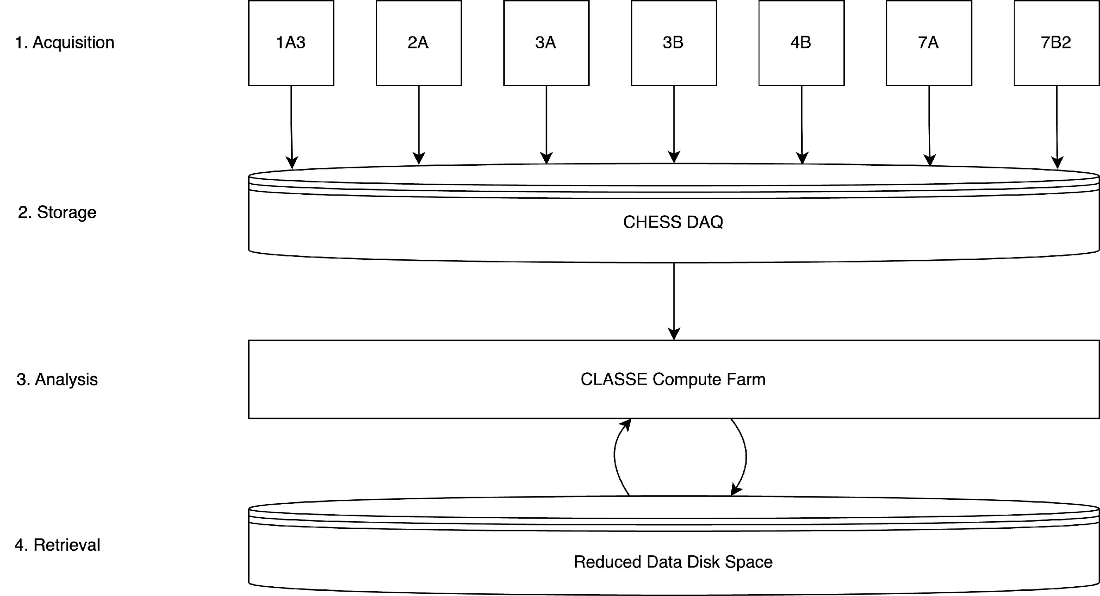
CHESS User Data Lifecycle
Notes:
Data acquisition starts at the station computer...
which is written to and stored on the CHESS DAQ...
which is a networked filesystem connected to our on-prem HPC system used for analysis jobs...
and reduced data generated over the course of an analysis workflow is written to another networked filesystem for later retrieval and further analysis

Slide 28
Data Challenges at CHESS – Collection & Access
A complete dataset consists of data from many sources: detectors, motors, ion counters, thermocouples, etc.
Collection strategies and formats vary between beamlines, techniques, and user groups
Variance in collection strategies -> almost no standard tools for:
Checking quality of incoming data
Sometimes, the best check is simply a visual inspection from an experienced eye
Current visualization tools are at least one of the following:
Hard to access remotely
Hard to use without prior training
Inaccessible after the data have been written to disk
Do not handle large datasets well
Accessing complete datasets that are ready for analysis
Disconnected data streams must be collected and oriented in the coordinate space of the measurement
Notes:
The “boutique” nature of CHESS -> patchwork of data collection strategies -> difficult for users to navigate their own data (even if they have a lot of computing experience). This means inefficient (and sometimes wasteful!) beamtimes
Challenges w/ Collection & Access are related:
"accessing" a dataset is a bit of a misnomer, they really must be constructed from these disparate data streams
if researchers can't access their data to confirm its quality, they could potentially waste their whole period of beamtime.

Slide 29
Data Challenges at CHESS – Collection & Access
A complete dataset consists of data from many sources: detectors, motors, ion counters, thermocouples, etc.
Collection strategies and formats vary between beamlines, techniques, and user groups
Variance in collection strategies -> almost no standard tools for:
Checking quality of incoming data
Sometimes, the best check is simply a visual inspection from an experienced eye
Current visualization tools are at least one of the following:
Hard to access remotely
Hard to use without prior training
Inaccessible after the data have been written to disk
Do not handle large datasets well
Accessing complete datasets that are ready for analysis
Disconnected data streams must be collected and oriented in the coordinate space of the measurement
Notes:
We can detect some (but not all) anomalies automatically, but we still need an experienced scientist in the loop to decide what the cause is, and what to do about it.

Slide 30
Data Challenges at CHESS – Analysis
Processing procedures vary significantly depending on the X-ray technique used
Some workflows currently require a significant amount of computing expertise even at the first stages of data inspection and reduction. For example:
Fluency in UNIX commands
Fluency with environment managers like conda
Intimate knowledge of the specific data collection strategies and formats used
Determining the computing resources needed to run an analysis job
Analysis is our users' main bottleneck to publishing
The actual science behind the analysis code is already difficult and new to many users – we can't require every one of them to become computing experts, too
Notes:
Difficult dataset access -> pipeline to FAIR, publishable data is not standard -> published science happens at reduced speed, and sometimes reduced trust
Volume of datasets vary, too:
Low end: 20MB (typical for energy dispersive diffraction)
High end: 60GB (typical for tomography)

Slide 31
Democratizing Synchrotron Science at CHESS
Establishing standards for collecting and accessing complete datasets
Constructing tools for running analysis pipelines that can be executed identically on the command line (ChessAnalysisPipeline), through a science gateway (Galaxy -- https://usegalaxy.org), or through a service that enables users to insert their own code into those pipelines (CHAPaaS)
Give researchers access to visualizations of their data at every stage of analysis
More experienced researchers perform quality checks and make decisions about how to perform the next step of data collection or analysis
Less experienced researchers build intuition for the technique used
Deeper understanding of the physics of the measurement
Intuition for what variables affect their data and how
All researchers become more responsible stewards of the measurements CHESS can provide
Notes:
Visualizations are (again) an accessible way to perform cursory quality checks of data at any stage of analysis
Volume of datasets vary, too:
Low end: 20MB (typical for energy dispersive diffraction)
High end: 60GB (typical for tomography)

Slide 32
Democratizing Synchrotron Science at CHESS
Establishing standards for collecting and accessing complete datasets
Constructing tools for running analysis pipelines that can be identically executed on the command line (ChessAnalysisPipeline), through a science gateway (Galaxy -- https://usegalaxy.org), or through a service that enables users to insert their own code into those pipelines (CHAPaaS)
Give researchers access to visualizations of their data at every stage of analysis
More experienced researchers perform quality checks and make decisions about how to perform the next step of data collection or analysis
Less experienced researchers build intuition for the technique used
Deeper understanding of the physics of the measurement
Intuition for what variables affect their data and how
All researchers become more responsible stewards of the measurements CHESS can provide

Slide 33
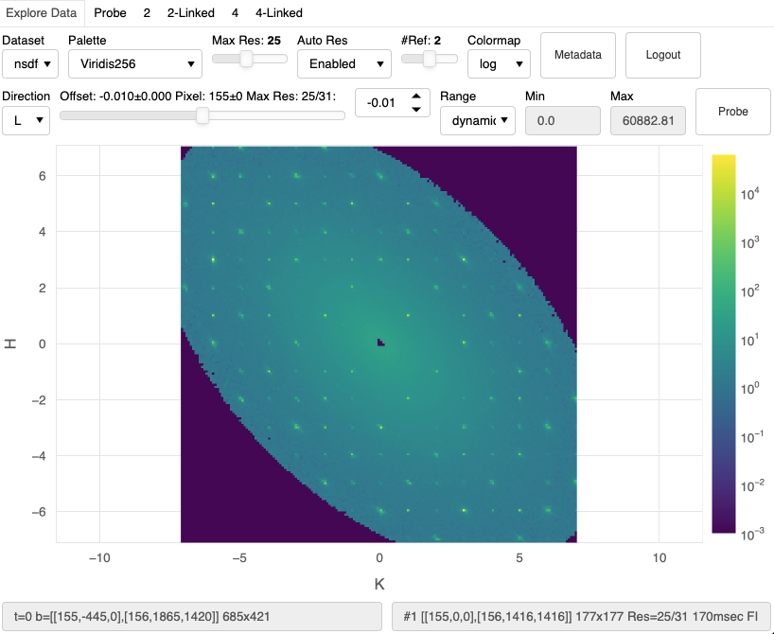
NSDF Data Visualization Dashboards
Web based
Automatically generated
Interactive
First CHESS user groups are using them right now!

Slide 34
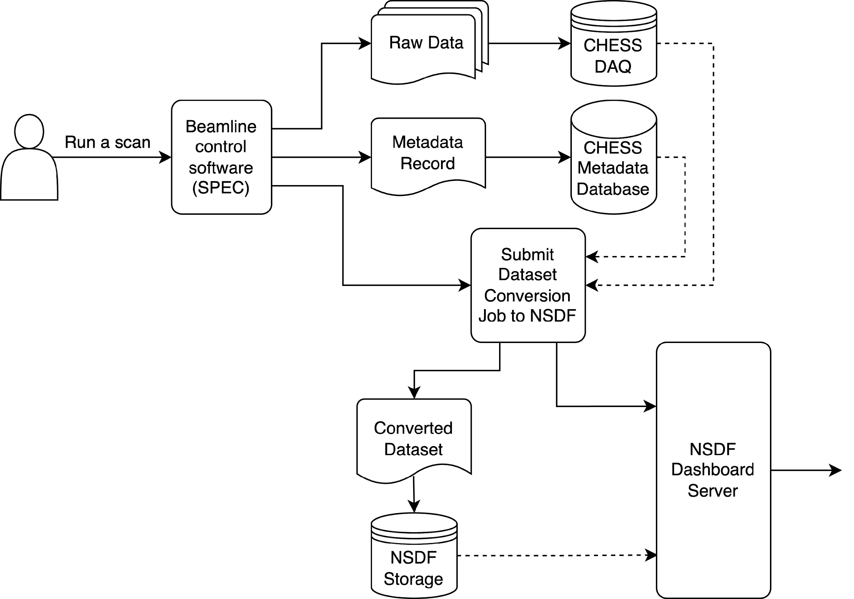
NSDF Data Visualization Dashboards

Slide 35
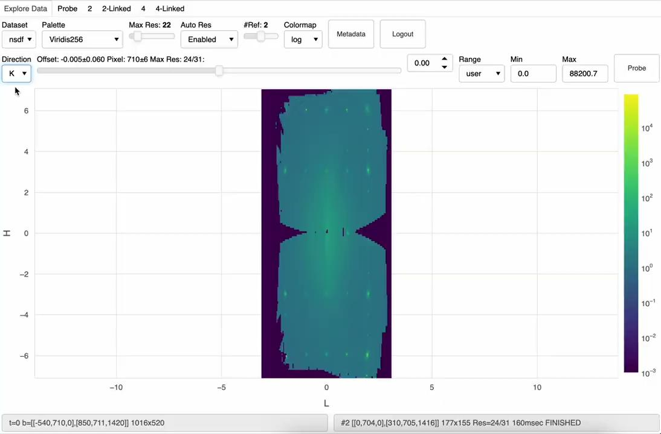
"Explore Data" Dashboard Mini-Demonstration

Slide 36
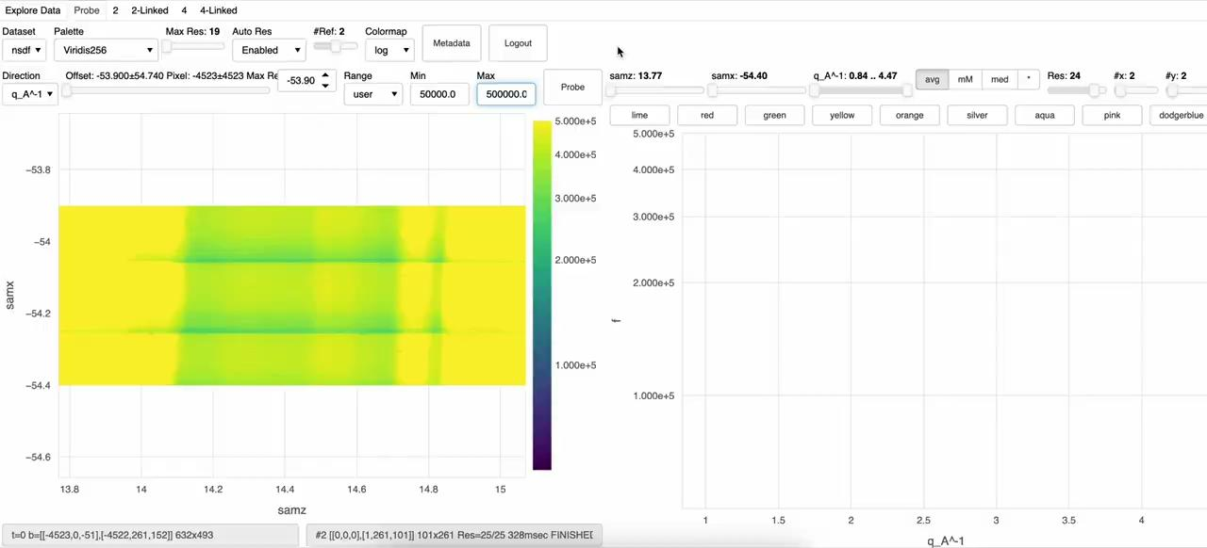
"Probe" Dashboard Mini-Demonstration

Slide 37
Acknowledgements
John Allison, Devin Bougie, Amy Gooch, Peter Ko, Kelly Nygren, Aashish Panta, Valerio Pascucci, Giorgio Scorzelli, Kate Shanks, Werner Sun, Michela Taufer, Rolf Verberg...and many others!

Slide 38
A National Science Data Fabric to Democratize Data Access and Reusability
Moderators: Valerio Pascucci (University of Utah), Michela Taufer (University of Tennessee Knoxville,
Christine Kirkpatrick (San Diego Supercomputer Center)
Participants: Heberth Martinez (University of Tennessee Knoxville), Keara Soloway (CHESS),
Chuntida Harinnitisuk (University of Texas Health San Antonio), Amy Roberts (University of Colorado Denver)
Notes:
INSERT NSF GRANT NUMBER

Slide 39
Navigating Data Expansion: Coping with Storage Islands and Data Analysis Complexity
Chuntida Harinnitisuk
Director, Enterprise Systems and Operations
UT Health San Antonio

Slide 40
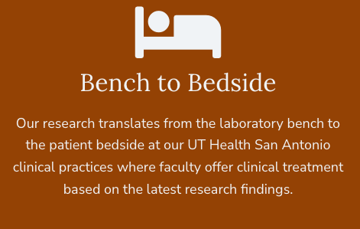
Making a Difference Through Research
We Make Lives Better
UT Health San Antonio is a dynamic and rapidly expanding health science center with six professional schools with missions of education, clinical care, research and community service. With a budget of $1.23 billion dollars, a work force of 7,900 and a research portfolio of more than $360 million, UT Health San Antonio is quickly rising in prominence among academic medical centers in the United States.
Notes:
About UTHSCSA and research

Slide 41
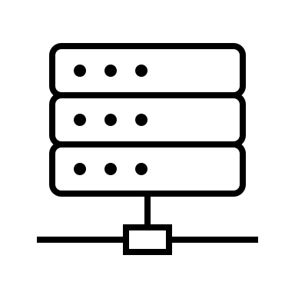
Challenges of Riding the Data Tsunami!
AD
Data Generators
On-prem Storage
National & Cloud Resources
2 PB +++ (25-50 TB/mo)
Scientific instruments, clinical, nextGen sequencers, Cryo-EM, Optical Imaging, media RAW/archive data
Primary Data Center
DR Data Center
Azure Archive storage
Unstructured Storage Tier 1
Unstructured
Tier 3
Unstructured Storage Tier 2
TACC
Ranch
TACC
Corral
Unstructured Storage Tier 3
100 TB++
Clinics and Hospitals
PACS, IoT
Backup Disk
Box
OneDrive
Block Storage
200 TB
personal / File shares
SharePoint
Block Storage
Block Storage
400 TB -
Virtual servers
Block Storage
AWS S3
Block Storage
Azure NetApp Cloud
500 TB + (10 TB/mo)
GENIE HPC, GPU desktops
Unstructured Storage
Tier 1
Epic Cloud
??? TB
Local labs, external drives, DVDs, CDs
Block Storage EOL
Block Storage EOL
2 PB ++
Backup & Replication Target
Object Storage EOL
Unstructured EOL
National Repository
National Repository
National Resources Centers – BioBanks, Genomics resources
Backup Disk EOL
Notes:
- High-Throughput Technologies: Next-gen sequencing, sophisticated software, and powerful computing systems are generating data faster than we can store
- Challenges: As we bring more faculty and their amazing research programs, it’s like squeezing more people into an elevator – our infrastructure needs to keep up
- How to get massive data from point A to point B
- Volume, variety and velocity of data
- how data silos often arise from isolated storage systems, restricting seamless data sharing and access.

Slide 42
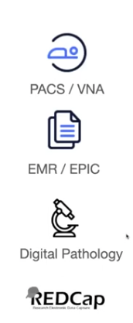
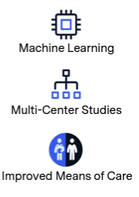
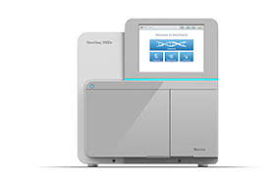
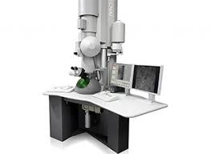
Challenges of supporting Multi-Modality Clinical Research and Life Science Workflows Analysis
Data Management Lifecycle
Data Lake /Repository
Data Curation
Image and Data Processing
Workflow
Data Transfer Mgmt
Sequencing
Research Community
Doctors
RII
Pathology
Biggs/Brain Health
Bioinformatics
Faculty
Next-Gen Sequencer
Analysis Tools 100+
Visualizing Sequence
Model building
Structure Analysis
Map Reconstruction
Cyro-Electron microscopy
Need data-centric tools throughout the imaging and non-imaging data lifecycle
Organize large data
Facilitate the reproducibility of data
Sharing active data internally/externally
Data retention compliance
Notes:
Select a unified platform or consistent approach that allow easy data access, retrieval, sharing, and collaboration that address a broad set of data use cases from clinicians, patients, faculty, researchers, students, staff, etc.
- critical insights were hindered due to the isolation of data and complexity of data analysis

Slide 43
Survey Poll from VPR-IT Town Hall Meeting – 111 attendees

Slide 44
Our Key Challenges with Research IT
Researcher doesn’t know where/who to get services/support. If they do, they can’t use grant money to pay annual chargeback
IT has limited knowledge and experience with research applications and workflows
Recruiting and retaining IT staff to support Research Computing
Researchers ask, and we sprint, not stroll, down the project management path!
Backing up data is like insurance – no one thinks they need it until it's too late, and suddenly, everyone wishes they had it.
Security Alert! Grant access to scattered data

Slide 45
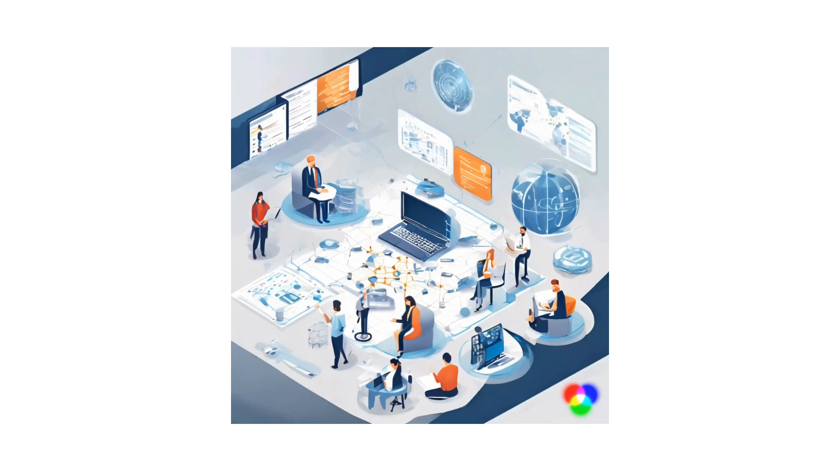
Unlocking Scientific Discovery: Collaborating with NSDF to Manage Massive Data Growth and Enhance Access
Notes:
To establish and operationalize an integrated ecosystem of storage, data management, compute resources and secure network infrastructure required to support researchers in every phase of the research lifecycle.
- the opportunities and potential collaborations that NSDF and similar projects present to the data science community.
- NSDF aims to democratize data-driven scientific discovery by breaking down barriers and connecting a network of institutions and integrate data delivery, storage, networking, computing, and education resources.
- how NSDF aims to address the challenges posed by data silos and accommodate the growing data needs in life science and clinical research.
-

Slide 46
A National Science Data Fabric to Democratize Data Access and Reusability
Moderators: Valerio Pascucci (University of Utah), Michela Taufer (University of Tennessee Knoxville,
Christine Kirkpatrick (San Diego Supercomputer Center)
Participants: Heberth Martinez (University of Tennessee Knoxville), Keara Soloway (CHESS),
Chuntida Harinnitisuk (University of Texas Health San Antonio), Amy Roberts (University of Colorado Denver)
Notes:
INSERT NSF GRANT NUMBER

Slide 47
What’s possible in dark matter science
With infrastructure and software support?
Amy Roberts, SC 23

Slide 48
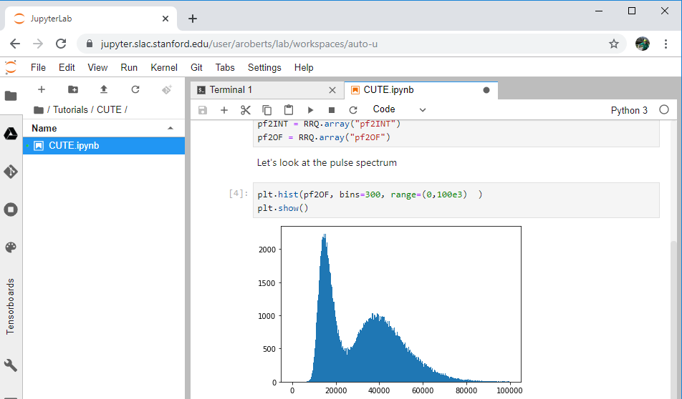
Better Software, Better Science
And Infrastructure!
Previously, everyone installed their own software stack. New students took months and sometimes years to make a plot
Moving to pre-installed, web-based environments cut that down to days/weeks
Now we have two “analysis sites” that we support by creating Singularity containers and ensuring copies of data in active use
Load is high at these two sites and we’d like to have more. The main blocker is data access.
Secondary Site
Primary Storage
Jetstream2
Open Storage Network
Amy Roberts, SC 23
ACCESS PHY210008

Slide 49
Who gets to do science?
In the “cosmic frontier”, it’s easiest for graduate students and postdocs to do science at institutions that have strong local IT resources (they can work on a well-supported, local cluster) and are in research groups that have research software engineers that are open to helping newcomers.
A colleague in neutrino physics: “There’s no way undergraduates could contribute to analysis in our experiment.”
Amy Roberts, SC 23

Slide 50
Better infrastructure, more science participation
A snapshot of my group at CU Denver (no central research IT, no research software engineers)
Zack Kromer is using machine learning to explore new ways to estimate bias in dark-matter data analysis
Kitty Harris is using Zack’s networks to estimate bias in her calibration analysis for dark-matter detectors
Abigail Gebramariam is building a workflow that makes Zack and Kitty’s work easier
Adrian Fisher is adding Kitty’s data to a data catalog to help Abigail’s workflow efforts and increase reproducibility
James Amidei is looking at a new way to identify backgrounds in our dark-matter search
Dan Mazin is extracting information about how germanium detectors respond to particle interactions
Gabriele Larson is making particle-astrophysics simulation files more accessible
Undergraduate students in bold
Amy Roberts, SC 23

Slide 51
Better infrastructure, more science participation
A snapshot of my group at CU Denver (no central research IT, no research software engineers)
Zack Kromer is using machine learning to explore new ways to estimate bias in dark-matter data analysis
Kitty Harris is using Zack’s networks to estimate bias in her calibration analysis for dark-matter detectors
Abigail Gebramariam is building a workflow that makes Zack and Kitty’s work easier
Adrian Fisher is adding Kitty’s data to a data catalog to help Abigail’s workflow efforts and increase reproducibility
James Amidei is looking at a new way to identify backgrounds in our dark-matter search
Dan Mazin is extracting information about how germanium detectors respond to particle interactions
Gabriele Larson is making particle-astrophysics simulation files more accessible
Students whose work requires the Open Storage Network in bold!
Amy Roberts, SC 23

Slide 52
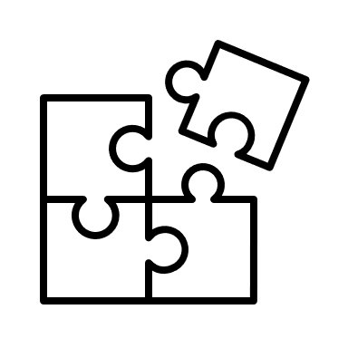
Pain points: need to support the full analysis workflow
We need more storage – one dark matter experiment can generate ~ 1 PB over its lifetime
We need a well-supported data catalog – my experiment technically has a data catalog but it’s end-of-life, difficult to use, and doesn’t have all the features we need for reproducible analysis
We need tools to access and analyze our data – ours are custom and lack support, they don’t integrate with e.g. non-local storage
Personnel!
To help us transfer our data to accessible storage and manage the data at analysis sites
To help us when we have trouble with the data catalog
To help with data-analysis tools
Amy Roberts, SC 23

Slide 53
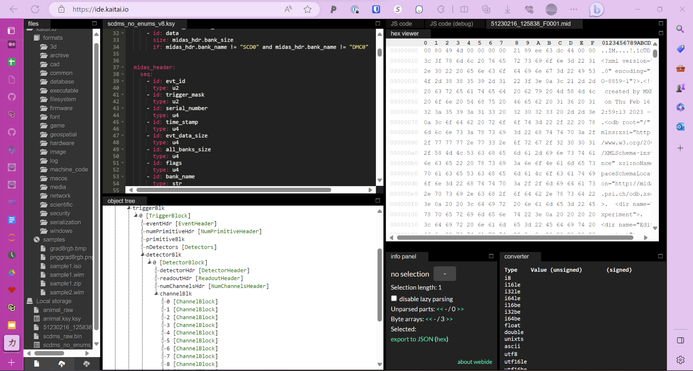
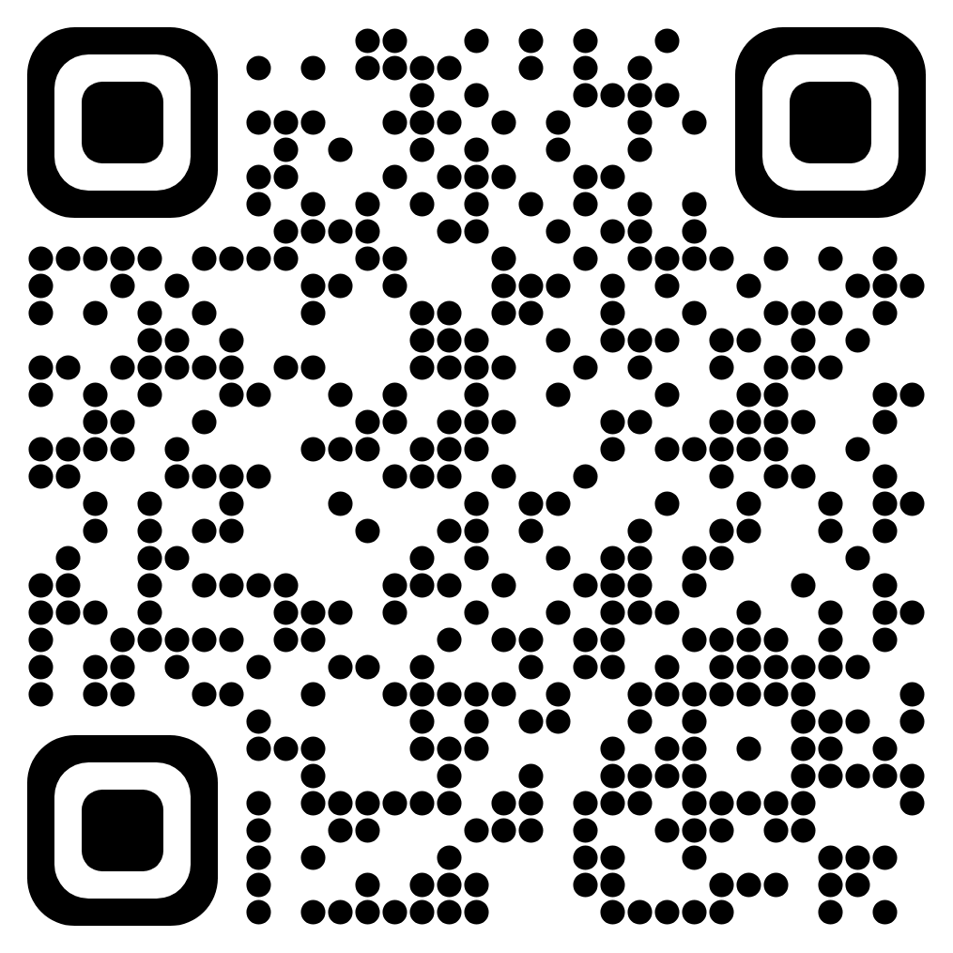
One part of the puzzle: custom-format data access
Support for small, non-standard, binary datasets already exists with open-source projects like Kaitai and DFDL. The PONDD project aims to add support for GB-scale files.
Thanks to Manasvi Goyal, Jim Pivarski, and Ianna Osborne for their work on this! Awkward Target for Kaitai Struct (zenodo.org)
Amy Roberts, SC 23
NSF Award 2104003

Slide 54
The end, thank you!
Amy Roberts, SC 23

Slide 55
How to get involved
Attend our All Hands Meeting (February 28-March 1, La Jolla, CA)
Stay tuned for more information about travel support for early career researchers!
Attend our Distinguished Speaker Webinar: “Big Data at Synchrotron X-ray User Facilities: Challenges and Opportunities” with Dr. Joel Brock, Director, Cornell High Energy Synchrotron Source (CHESS) on December 12, 2pm ET
Participate in a User Community Interview
Follow NSDF on X and LinkedIn

Slide 56
A National Science Data Fabric to Democratize Data Access and Reusability
Moderators: Valerio Pascucci (University of Utah), Michela Taufer (University of Tennessee Knoxville,
Christine Kirkpatrick (San Diego Supercomputer Center)
Participants: Heberth Martinez (University of Tennessee Knoxville), Keara Soloway (CHESS),
Chuntida Harinnitisuk (University of Texas Health San Antonio), Amy Roberts (University of Colorado Denver)
Notes:
INSERT NSF GRANT NUMBER

