Slide 1
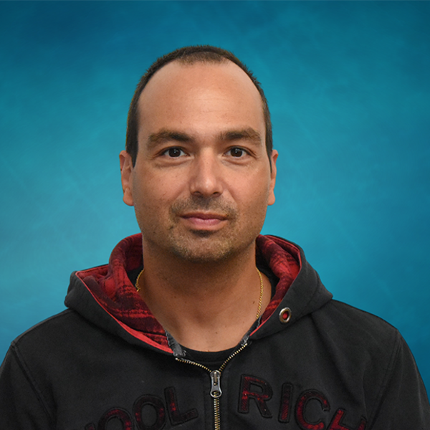
NSDF Pilot Deployments: CHESS, NASA, Catalogs
Valerio Pascucci, University of Utah
Kate Shanks,
Cornell
Kelly Nygren,
Cornell
Giorgio Scorzelli, University of Utah
Nina McCurdy,
NASA
Pania Newell,
University of Utah
Jakob Luettgau, UTK
Heberth Martinez,
UTK
Werner Sun,
Cornell
Aashish Panta,
University of Utah
NSF AWARD #2138811
Glenn Tarcea,
University of Michigan

Slide 2
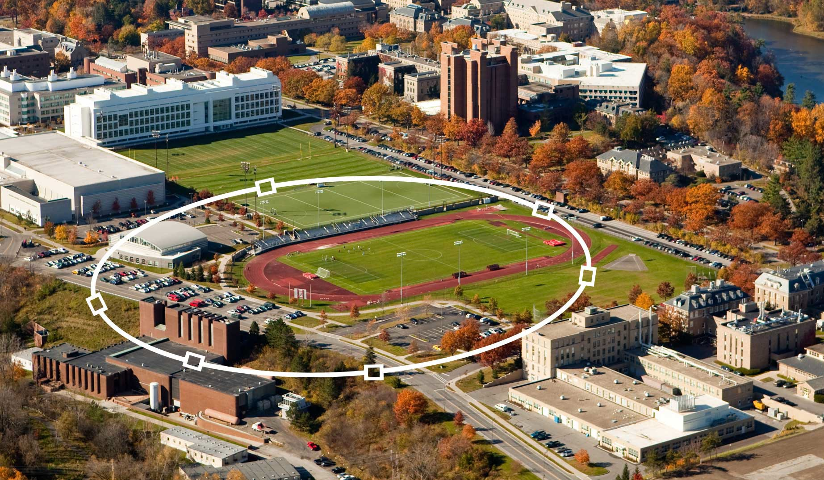
Cornell Laboratory for Accelerator-based Science and Education
CLASSE
CHESS X-Ray user facility
https://www.chess.cornell.edu https://www.classe.cornell.edu/Research/
Seven beam lines
Three sub-facilities, supported by the NSF, NIH, and AFRL
Macromolecular crystallography, structural biology, chemistry, quantum materials, and material science
New Experimental Hall to house the 20 Tesla High Magnetic Field beamline
•
•
•
Accelerator Physics
CESR, CesrTA, SRF, ERL
Particle Physics and Astrophysics
CMS, Cosmology, Muon g-2, HEP Theory, Theoretical Astrophysics
Center for Bright Beams
•

Slide 3
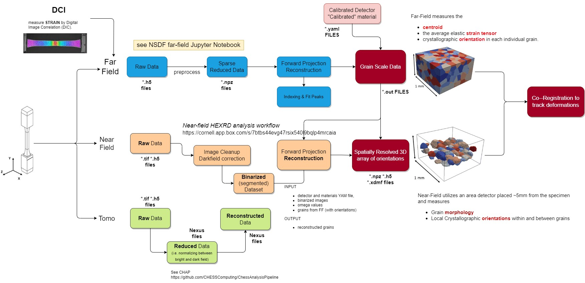
Democratizing Access to CHESS Beamline Data

Slide 4
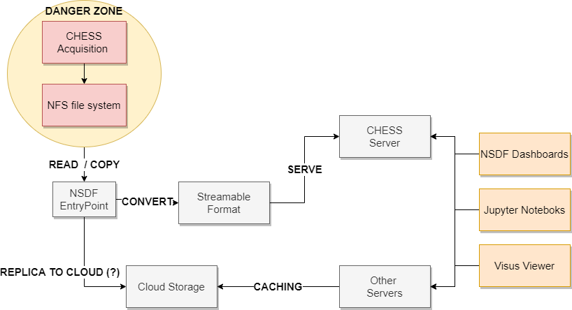
NSDF@CHESS beamline data collection workflow
OpenViSUS remote viewer
PROBE and other web dashboards
Personalized Jupyter notebooks
NSDF trustworthy services @ CHESS:
Only HTTPS port exposed
SSH tunneling options
Other external server with block caching

Slide 5
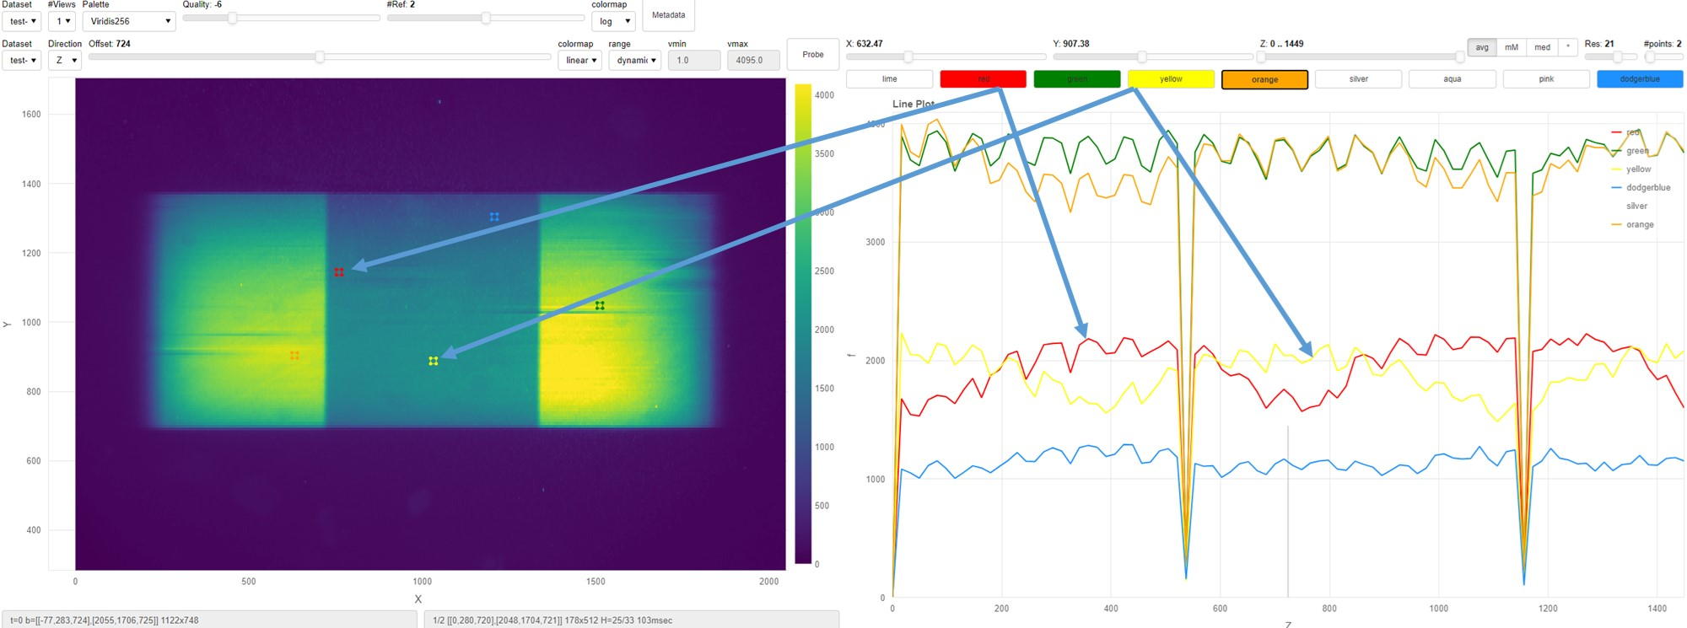
NSDF@CHESS: PROBE web dashboard

Slide 6
NSDF@CHESS: PROBE web dashboard

Slide 7
NSDF@CHESS: PROBE web dashboard

Slide 8
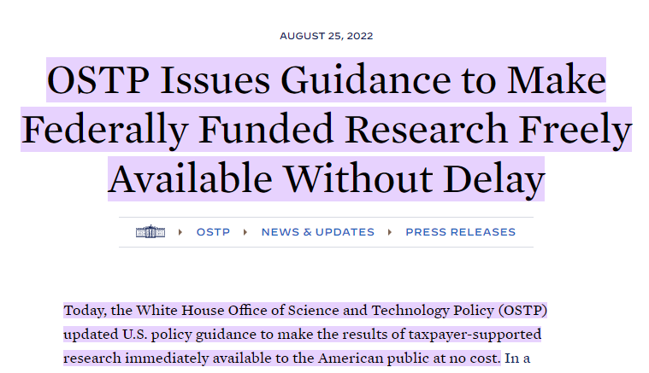
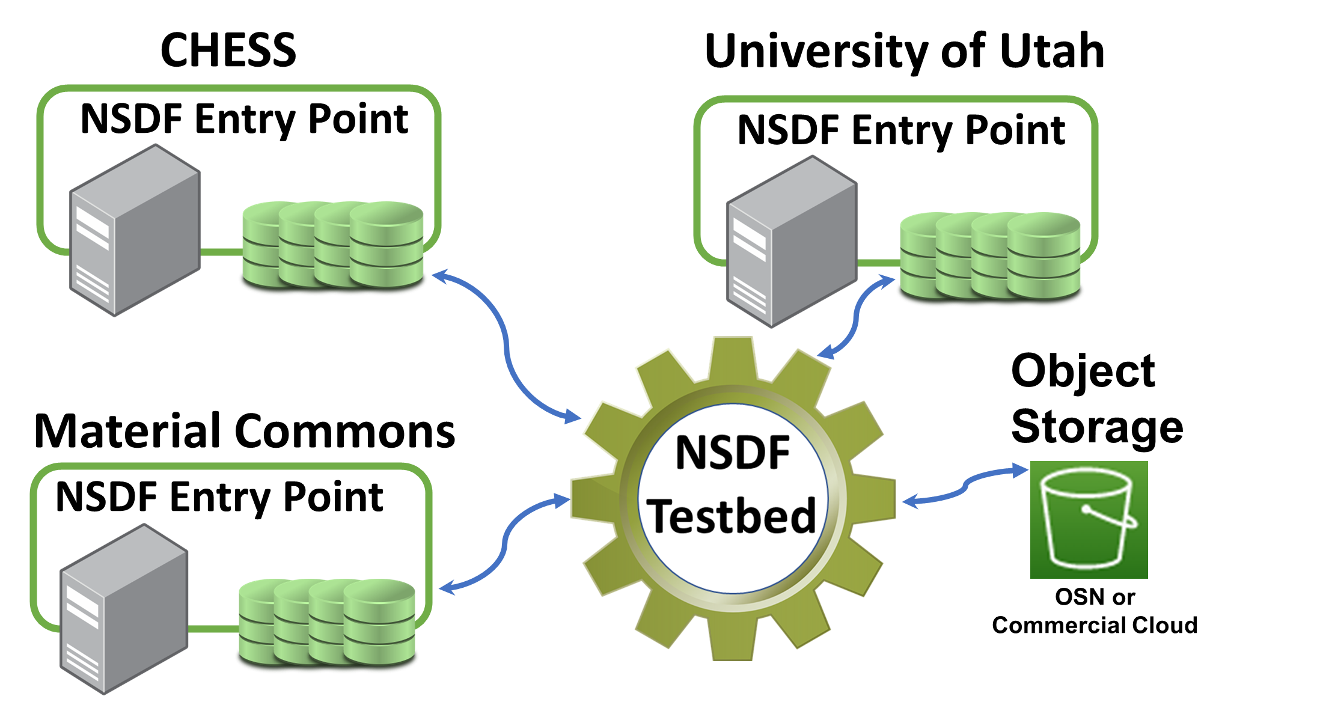
NSDF@CHESS Democratizing Access to Beamline Data
Data published through the OpenVisus server
NSDF EntryPoint enables immediate sharing
Automatic transfer to long-term storage: cloud, federated server, …

Slide 9
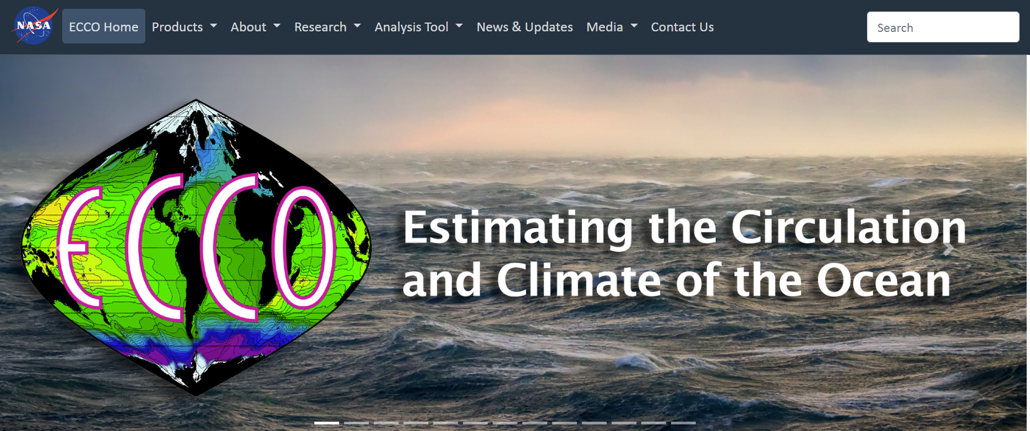
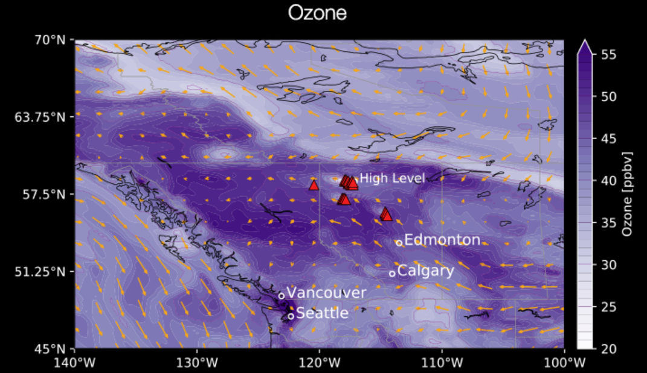
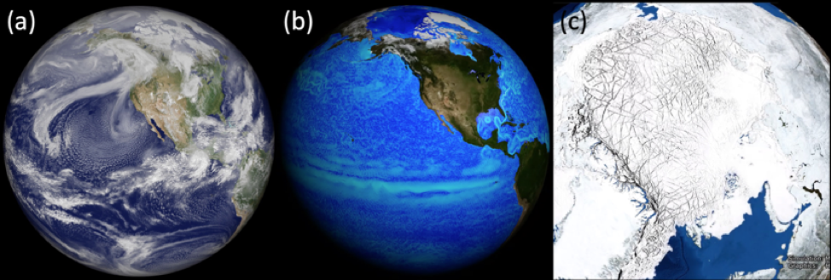
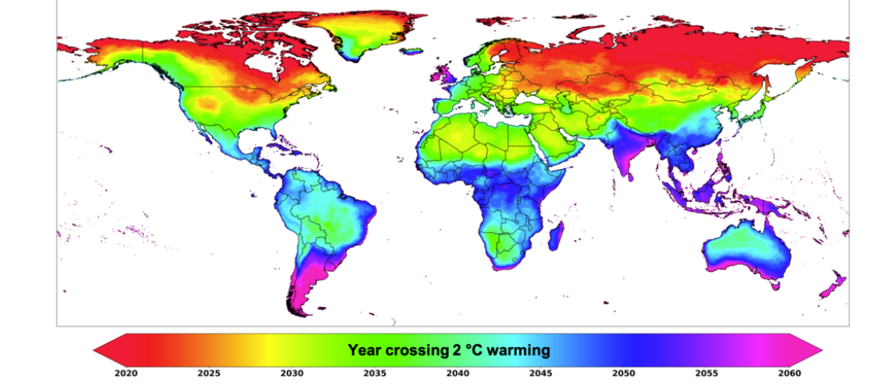
NSDF@NASA: democratizing access and exploration to petascale climate modeling data (4PB)
Estimating the Circulation & Climate of the Ocean (ECCO)
GEOS-5: A High Resolution Global Atmospheric Model
MIT general circulation model (MITgcm)
Downscaled Climate Projections (NEX-GDDP-CMIP6)

Slide 10
NSDF@NASA
- Easy, interactive exploration of petascale climate data (4PB).
- Deployment of Jupyter notebooks on Pleiades Supercomputer.

Slide 11
NSDF@NASA: democratizing access and exploration of petascale climate modeling data (4PB) through web portals

Slide 12
Scalable NSDF Catalog. How many “foam” datasets are in Material Commons and Digital Rocks Portal ? Do we have access to enough for ML training?
HDF5 files larger than 10GB?
group by file tagging (e.g., microscopy)?
How MUCH SCIENTIFIC DATA IS available?
What is the historical plot of OPEN DATA in time?

Slide 13
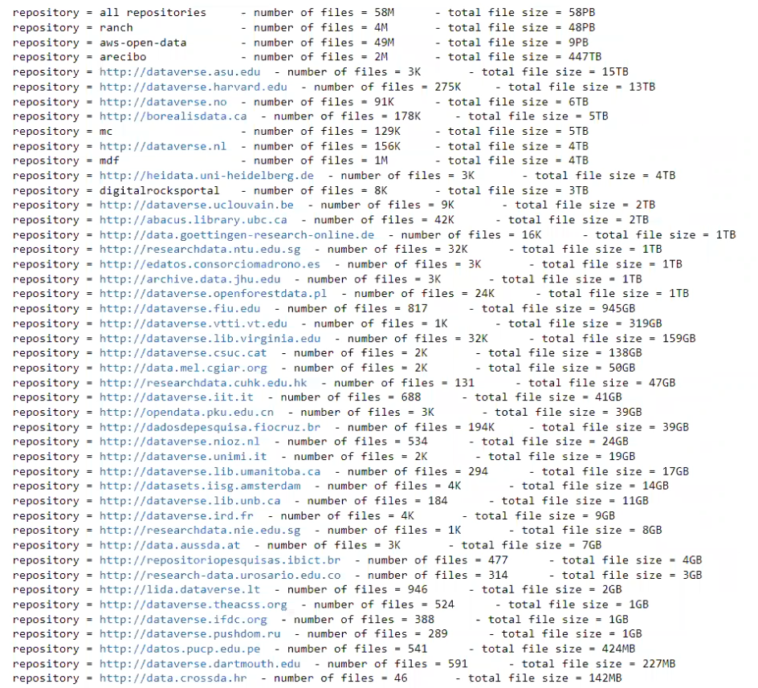
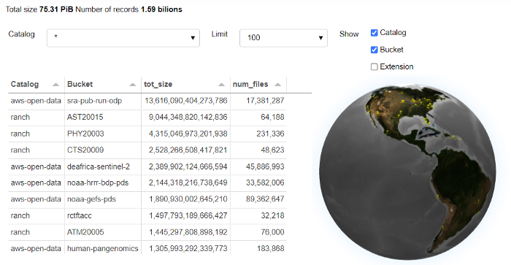
Multi-federation Catalog for 75PB of Community Data, 1.6 Billion Records
Industry-Academia Partnership

Slide 14
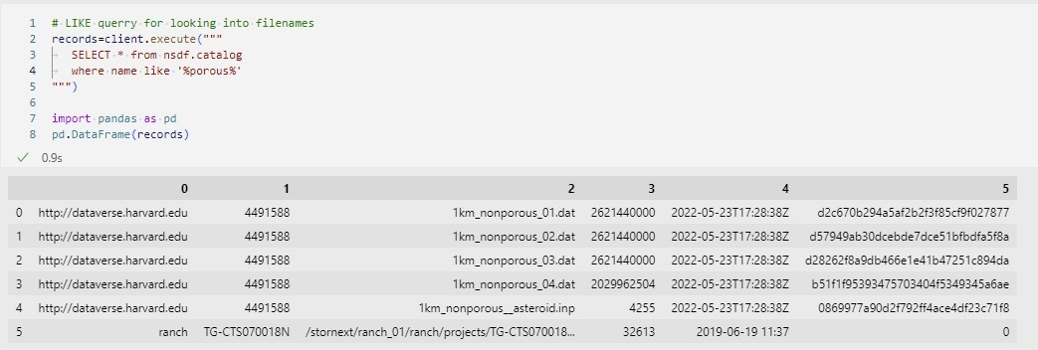
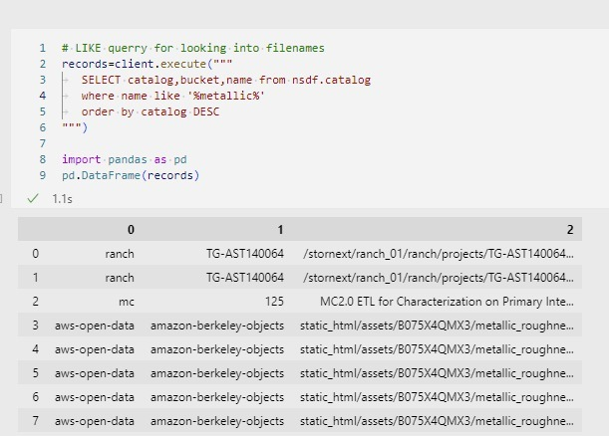
Searching for data across multiple repositories
Search for experiments with “metallic” compound
query
output

Slide 15
NSDF Catalog
Challenges:
Scalability
Full FAIR support
Interoperability of schema

Slide 16
NSDF: instant relief for your data pain!
- Technological progress needs to be connected to the needs of users and facilities
- Education and training of user communities is key to making impact
- Emphasis on open APIs to improve integration and interoperability among tools
Try our dashboards, and let us know if you need one!

